Slide 1
12.714 Computational Data Analysis
Alan Chave (alan@whoi.edu)
Thomas Herring (tah@mit.edu),
http://geoweb.mit.edu/~tah/12.714

Slide 2
Today’s class
Non-parametric Spectral Estimation
Estimation of Mean
Estimation of autocovariance sequence
Naïve spectral estimation: Periodograms
Bias reduction - Tapering
Basic Idea: Determine s_{τ} and the acvs determine spectrum
Notes:
Need to determine mean and avcs.

Slide 3
Estimation of mean
A natural estimator for the mean and its definition as a consistent estimator is
Chebyshev’s inequality shows
Variance of the mean:
Notes:
If Stau is white noise, Variance of mean deduces to std formulas S(0)/N.

Slide 4
Variance of Mean estimate
We now may consider when N goes to infinity
The sample mean is not always a consistent estimator for a stationary process. A process where the sample mean converges to the expectation is an ergodic process
Notes:
Thus when the acvs has a funite infinite sum, the mean is a consistent estimator of the expectation.
A simple non-ergodic process is one with a constant acvs (ie. All samples are perfectly correlated and no matter how many samples are averaged the variance of the mean remains the same (and equal to the variance of a single sample).

Slide 5
Asymptotically efficient estimators
If we know the covariance matrix, , for the samples from our process then
Then mean is asymptotically efficient if
Example: Fractional difference process has
Notes:
Mean is a poor estimator when S(.) rapidly decreases to zero as f->0.

Slide 6
Estimation of Autocovariance Sequence
A natural estimator for s_{τ} is
If the process expectation is used above (rather than the sample mean, the expectation of this estimate is s_{τ} and this is an unbiased estimate for all τ≤N-1.
When the sample mean is used, the estimate is biased.
An another (usually preferred) estimator is
Notes:
The p stands for “periodogram” (discussed later) not preferred.

Slide 7
ACVS estimators
The expectation of s_{τ}^{(p)} is (and a biased estimator for large τ
The two estimators are called the unbiased and biased estimates (even though the unbiased is also biased when the sample mean is used).
In some cases the “unbiased” estimate has larger biases than the biased estimate (eg. AR(2) process)
Which estimator should be used?

Slide 8
Properties of acvs estimates
In many cases the mean square error (mse) is smaller for the biased estimator i.e.,
Because the mse = variance + bias², the applies when the variability in s^{(u)} is more harmful than the biase in s^{(p)}. Specifically, for large τ, s^{(u)} is divided by N-τ where as s^{(p)} is divided by N and therefore will be smaller. This is useful when st approach zero for large τ.
Since correlation is avcs/variance, the s^{(u)} estimator can generate correlations > 1, whereas s^{(p)} will always be positive definite.
Figures on page 192 of PW show these effects

Slide 9
Periodogram: Naïve Spectrum estimation
For a discrete, real valued stationary process with zero mean we have
If we s^{(p)} in the above equation we have
S^{(p)}(f) is known as the periodogram (though depends of f).
Notes:
Notice here we can Fourier transform the acvs or Fourier transform the time series and square it.

Slide 10
Periodogram
The periodogram is defined in the Nyquist frequency range
If is related to the Fourier transform with the factor Δt/N instead of (Δt)².
For discrete frequencies and times we have

Slide 11
Properties of periodogram
If S^{(p)}(f) were an ideal estimator we would have:
For some processes [1] is a good approximation but for others it can be very poor;
[2] is blatantly false when S(f)>0 and
[3] holds for certain discrete frequencies (namely the Fourier frequencies).

Slide 12
Expectation of S^{(p)}(f)
The expectation of S(p)(f) is given by
D_{N}(.) is Dirichlet’s Kernel and F(.) is Fejér’s Kernel.
Notes:
Hence if we know the true spectrum we can determine what the expectation of our estimate is.

Slide 13
Properties of Fejér’s Kernel
For all N≥1 F(f)→NΔt as f→0.
For N>1, f∈[-f_{(N)},f_{(N)}] and f≠0, F(f)<F(0)
For f∈[-f_{(N)},f_{(N)}] and f≠0, F(f)→0 as N→∞
For any k≠0 and f_{k}=k/(NΔt), F(f_{k})=0 (happens because sin(kπ)=0)
The integral of F(f) over the Nyquist frequency range is 1.
As N goes to infinity, F(f) acts like a Dirac delta function and S^{(p)}(f) approaches S(f).
Following figures show F(f) for N=4, 16 and 64

Slide 14
Plots of Fejér’s Kernel
Notes:
In all cases, the first side lobe os 13dB down.

Slide 15
Bias in periodogram
The amount bias in the periodogram depends of the nature of the spectrum (particularly its dynamic range).
If the acvs is such that:
This only tells us the rate of change of bias, not the magnitude of the bias.
Biases in periodograms are shown in next two slides for an AR(2) and AR(4) process

Slide 16
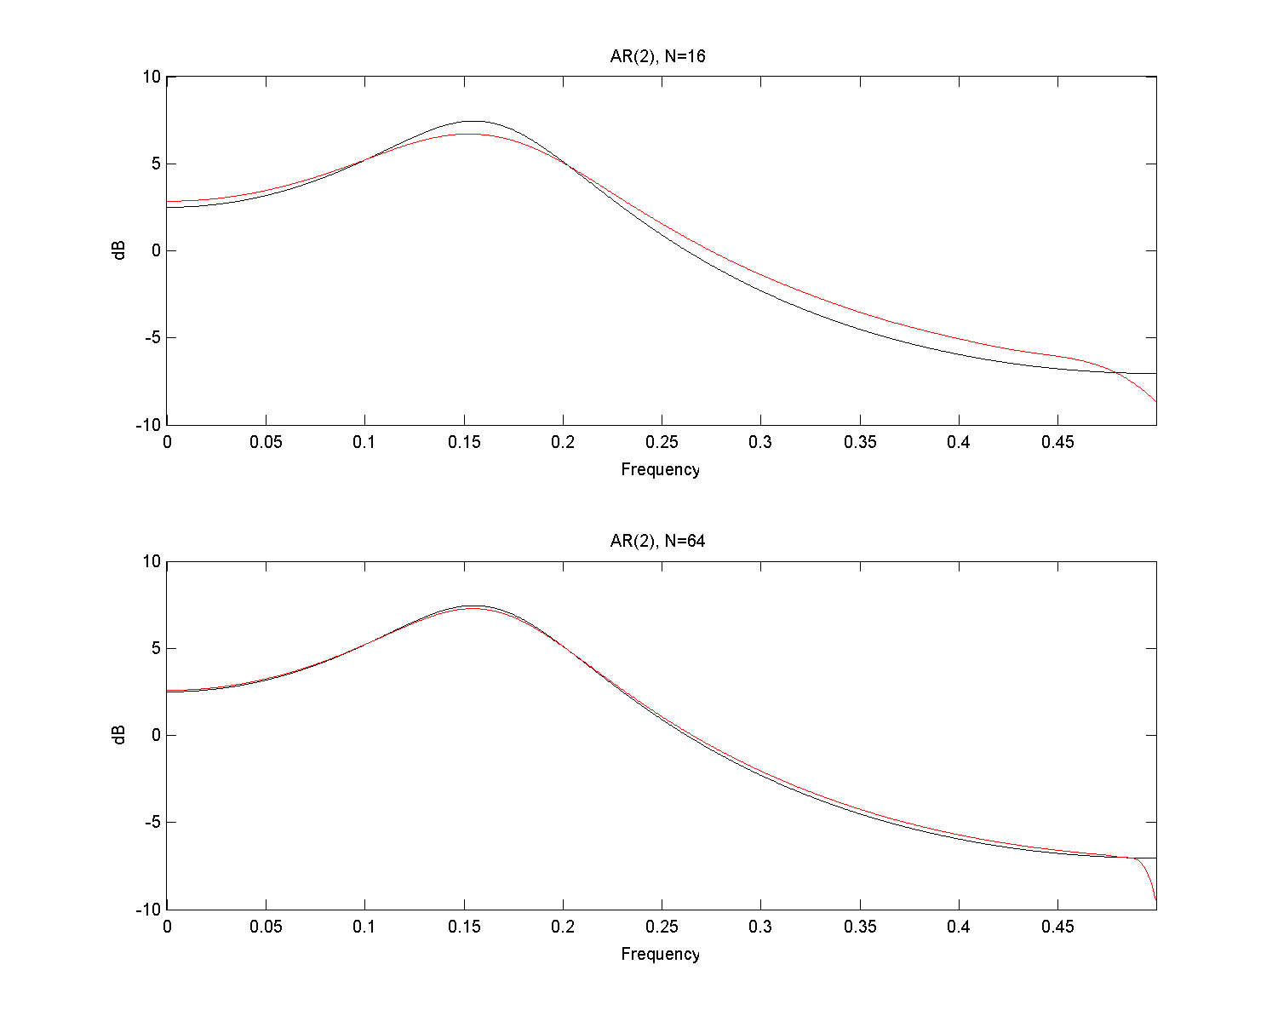
AR(2): N16, 64
Notes:
The drop off above f=0.45 is an artifact of the way the spectrum was (numerically) convolved with the Fejer’s Kernel.

Slide 17
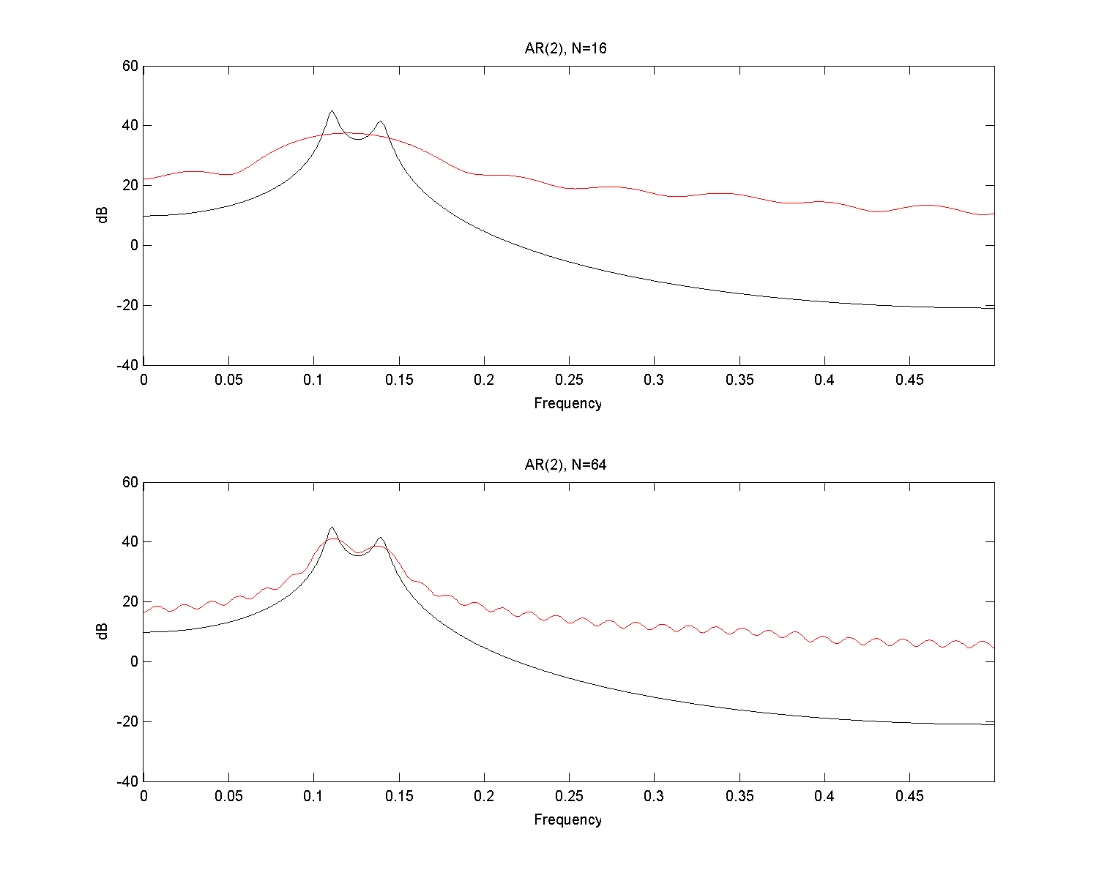
A4(4), N=16,64

Slide 18
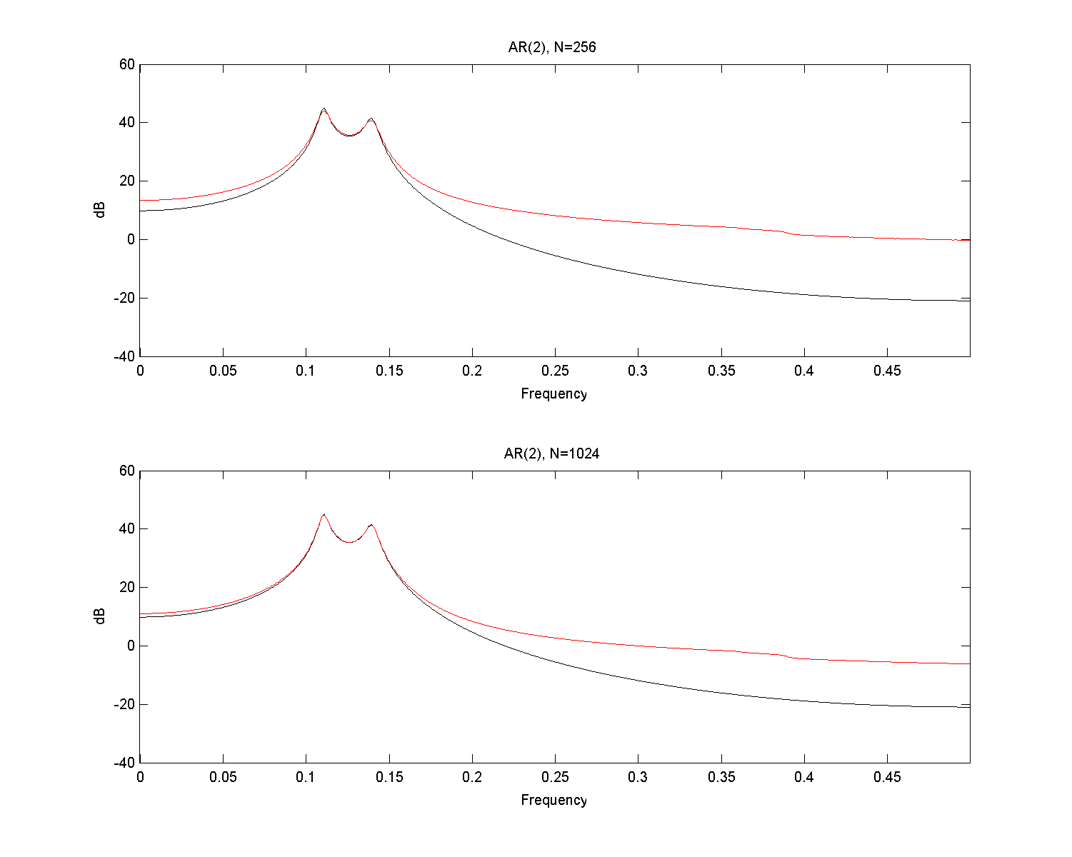
AR(4), N=256, 1024

Slide 19
Bias in Periodograms
The bias in the periodograms is arising in the spectra that have high dynamic range.
The biases arise from the sidelobes in the Fejer’s kernel. This transfer of power is called leakage.
There are two common techniques for lessening the biases:
Tapering : Modifies the kernel to reduce the sidelobes (at the expense of something else).
Pre-whitening : Pre-processes the time series to reduce the dynamic range.

Slide 20
Bias Reduction: Tapering
Tapering a method reducing the side lobes in the Fejer’s kernel.
A products is formed h_{t}X_{t} where h_{t} is a sequence of real values called a data taper (also known as a data window, linear taper, linear window, fader and shading sequence).
With a data taper we have
Notes:
Note difference between capital eta and capital H

Slide 21
Types of Tapers
Simplest: h_{t}=1/√N for 1≤t≤N called the rectangle or default taper. This case is the standard periodogram.
By setting the normalization such that sum over N of h_{t}²=1, the expectation integrated power under S(d) over the Nyquist frequency range will equal that under the true spectrum.
The integral of Η(f) over the Nyquist range will also equal 1.
The idea is select h_{t} to minimize sidelobes. Since sharp edges generate ripples, one method is to smooth the edges of rectangular taper.
One common method is a cosine taper.

Slide 22
Cosine tapers
The cosine taper called the p% cosine taper is defined by
C is a constant such that the sum of h_{t} is 1.
When p is 100%, the taper called a Hanning Taper.

Slide 23
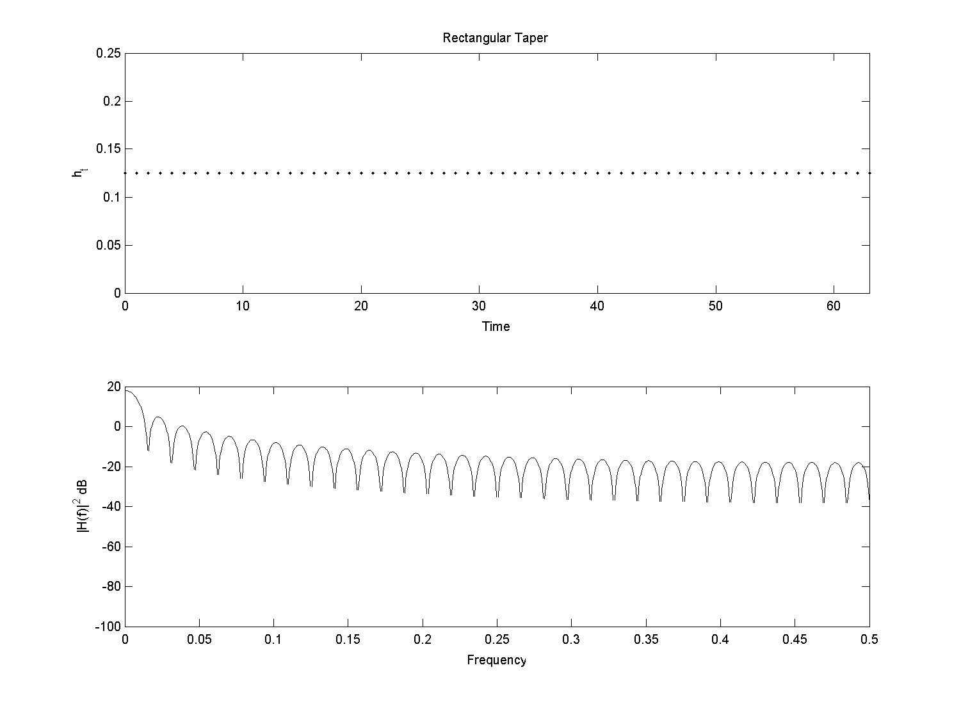
Rectangular Taper

Slide 24
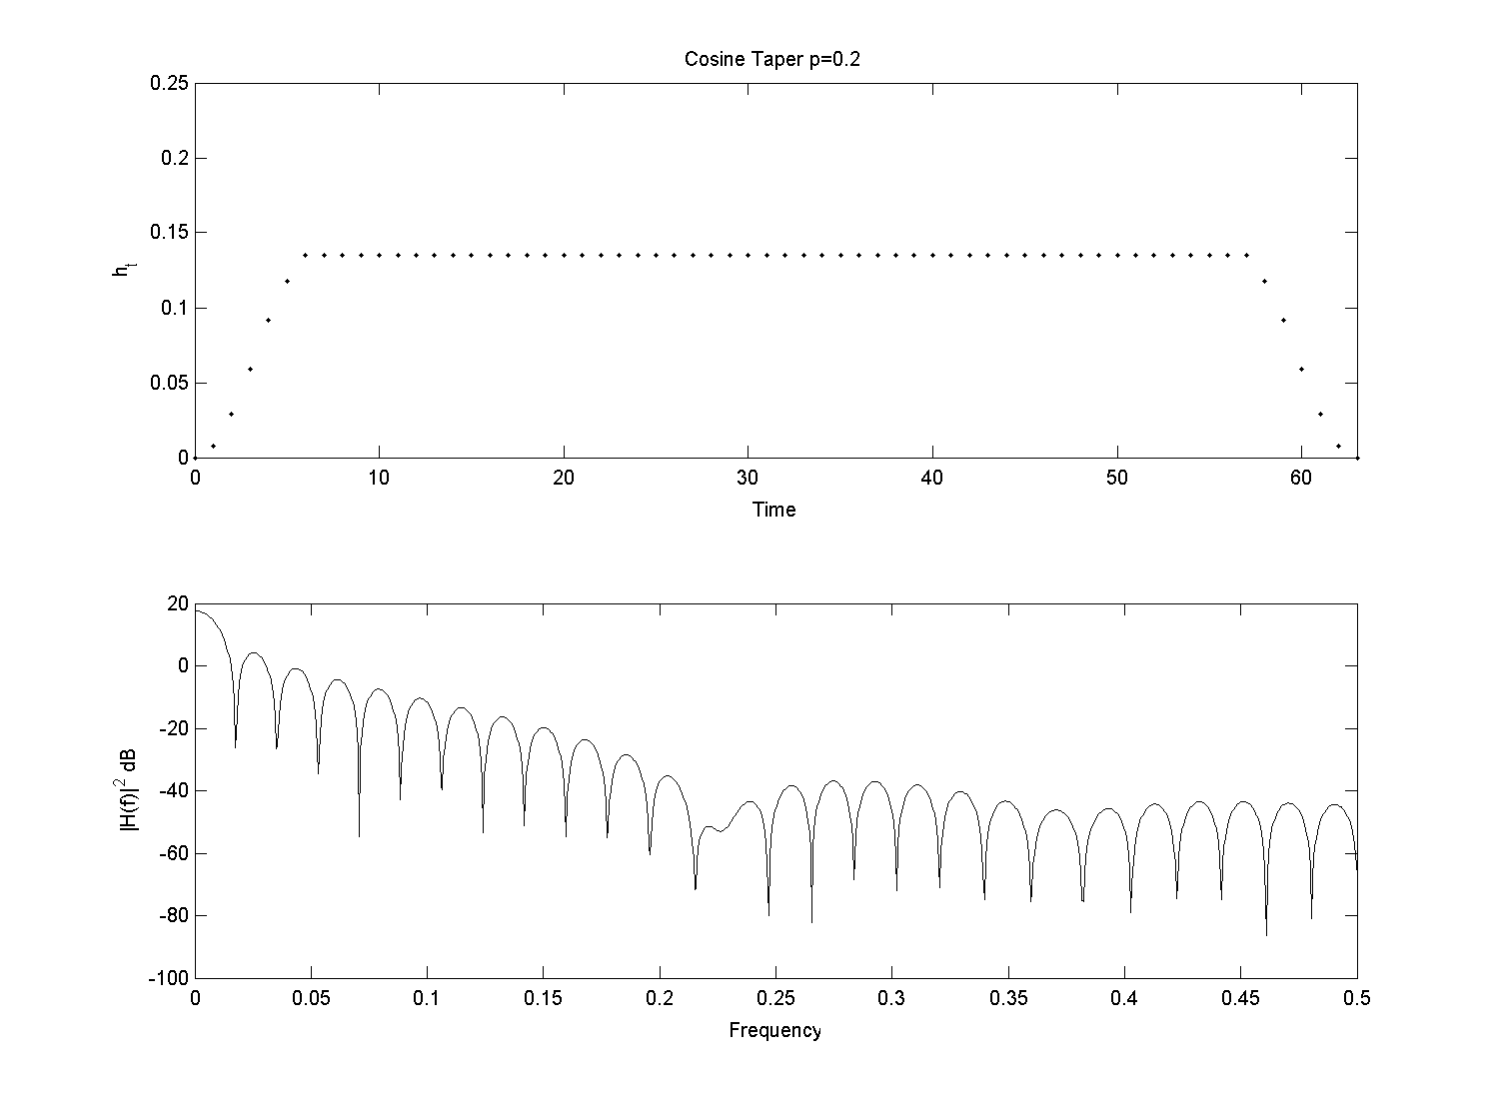
20% Cosine

Slide 25
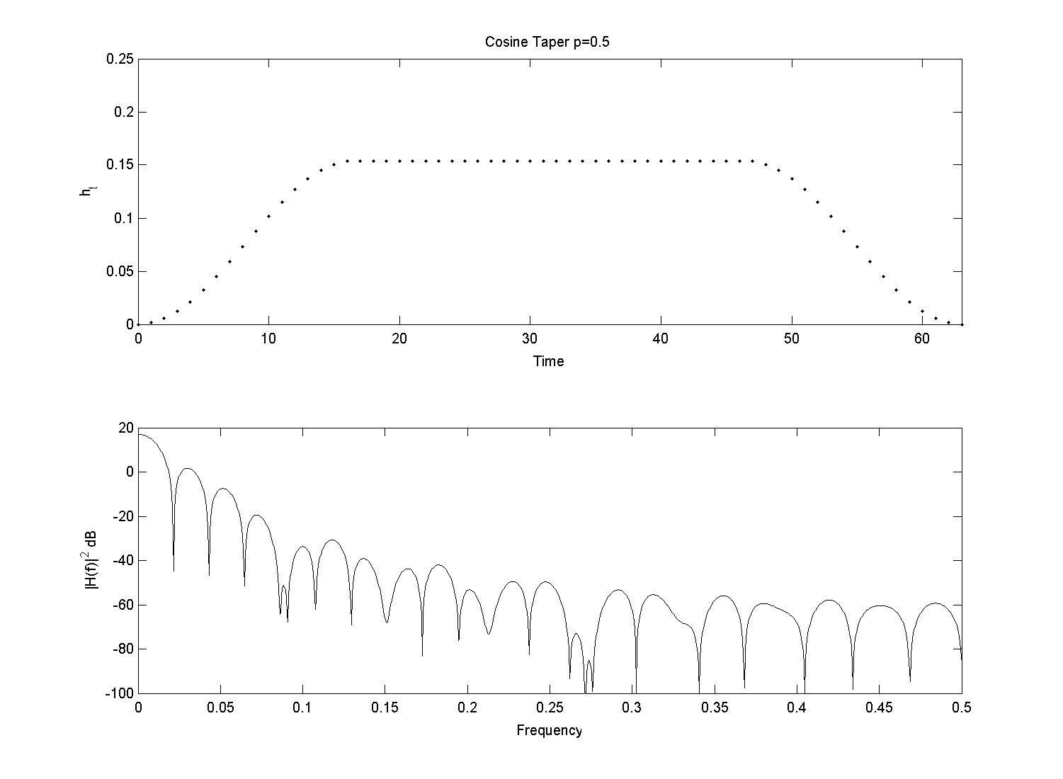
50% Cosine

Slide 26
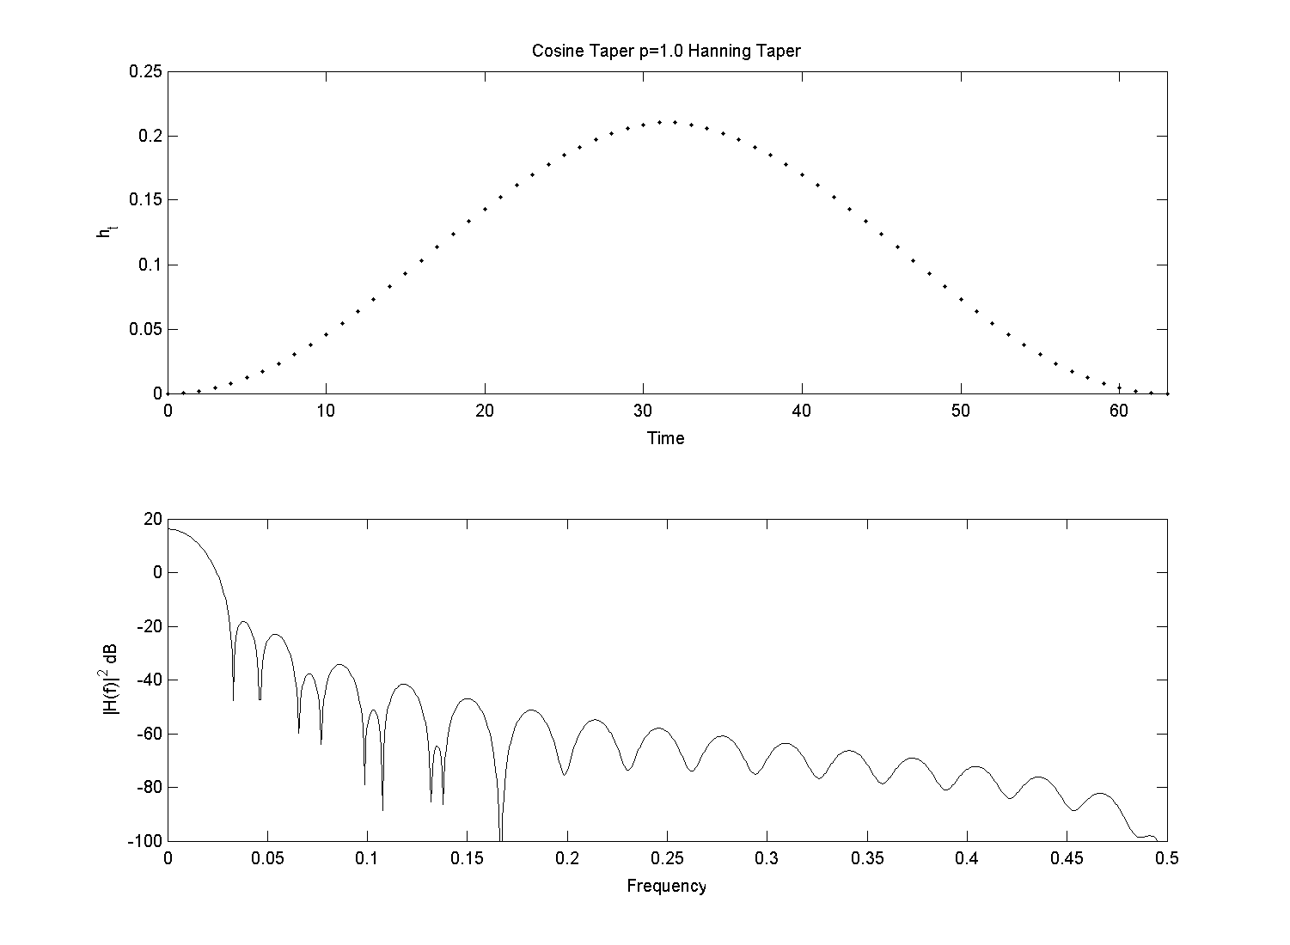
100% Cosine (Hanning Taper)

Slide 27
Summary of Today’s class
Non-parametric Spectral Estimation
Estimation of Mean: Possible problems with some processes
Estimation of autocovariance sequence: Concepts of biased and unbiased estimators
Naïve spectral estimation: Periodograms
Leakage and bias in this method
Depends on dynamic range.
Bias reduction - Tapering: One method for reducing bias.

