Slide 1





Examples using track
T. A. Herring¹ M. A. Floyd¹ M. Perry²
¹Massachusetts Institute of Technology, Cambridge, MA, USA
²University of Montana, Missoula, MT, USA
GPS Data Processing and Analysis with GAMIT/GLOBK and track
Hotel Soluxe, Bishkek, Kyrgyzstan
2–7 July 2018
http://geoweb.mit.edu/~floyd/courses/gg/201807_Bishkek/
Material from R. W. King, T. A. Herring, M. A. Floyd (MIT) and S. C. McClusky (now at ANU)

Slide 2
Outline
Kinematic examples
  GPS seismology
  Roving GPS
Kinematic/static example
  Rapid deformation
  Episodic and continuous deformation
Static examples
  Short-static occupations
  Deciphering interference
Remember the rule-of-thumb for proportional errors:
  ε_{BL} ~ ε_{SV} × BL/h_{SV}

Slide 3
Example 1: GPS seismology
April 4, 2010 El-Mayor Cucapah earthquake in Baja California: 5-Hz results. Look later at long baseline processing for these sites.
Track results are generated in two steps:
  First solution uses zero process noise except during time of earthquake (long baseline solution)
  Final results generated with fixed ambiguities from first solution read in (-a option).
  Long baseline ambiguity resolution with stochastic site coordinates needs LC estimate which can noisy due to stochastics.

Slide 4
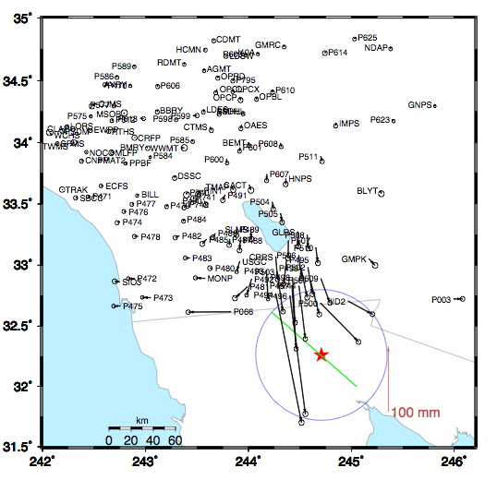
Coseismic offsets
Offsets based on 2-days before and after earthquake.
Two days used is reduce leakage of postseismic motions.
Red Star is epicenter; blue circle is 60 km (15-20 seconds surface wave speed)

Slide 5
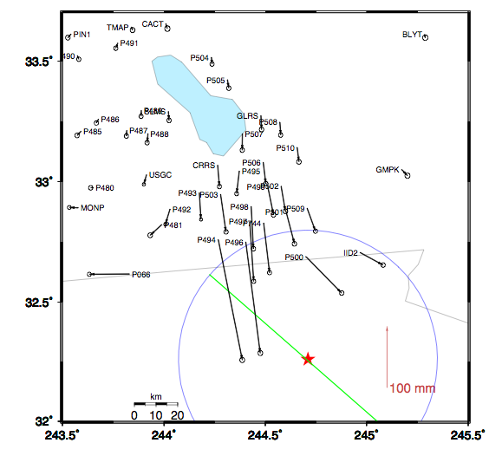
Zoom around border
Sites near the epicenter.
Blue circle is 60 km radius
Displacements
P494 200 mm
P496 182 mm
P497 97 mm
…
P491 9 mm

Slide 6
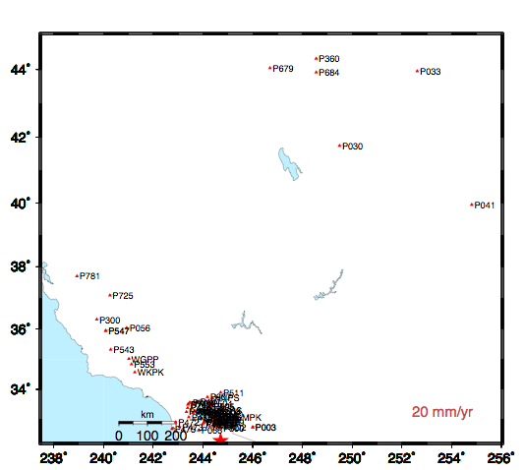
High-rate GPS site download
1Hz reference site
High rate data from these sites downloaded after event.
Most sites are 5-Hz; more distant sites are 1-Hz.
Reference site for high rate positioning

Slide 7
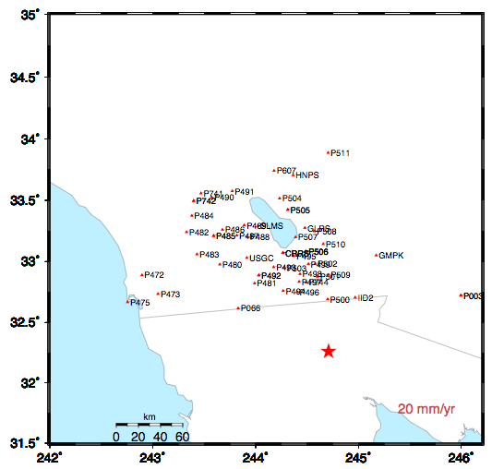
Sites in coseismic region
Sites shown have 5-Hz data for 3-days before and after the earthquake
Examine sequence of sites along US/Mexico border and North
Notes:
Sequence in next slides: P494, P496, P500, P066, P473, P472.

Slide 8
P496

Slide 9
P494

Slide 10
P500

Slide 11
P066

Slide 12
P473
Notes:
Note that this and the next site are similar distances from the epicenter but P742 is along the San Andreas. Also point out the 220-sec arrival

Slide 13
P742

Slide 14
Surface wave arrival at P725
P725 is ~600 km from epicenter. This signal common to sites is the arrival at the “reference site”
Notes:
Low rate data from distance reference site (with sign flipped)

Slide 15
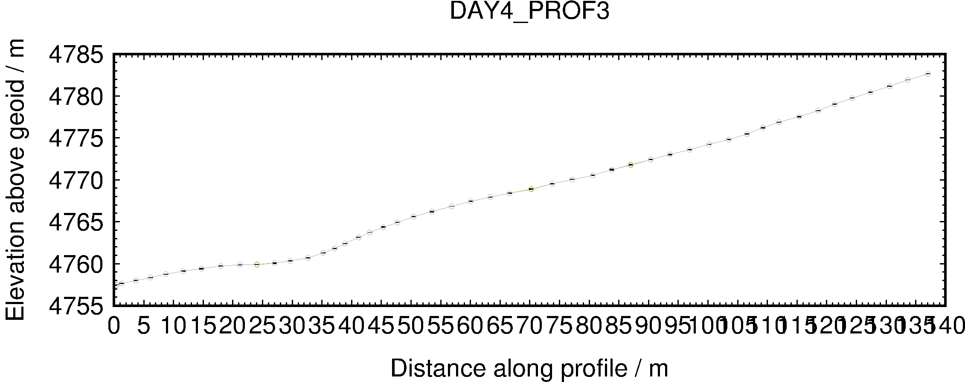
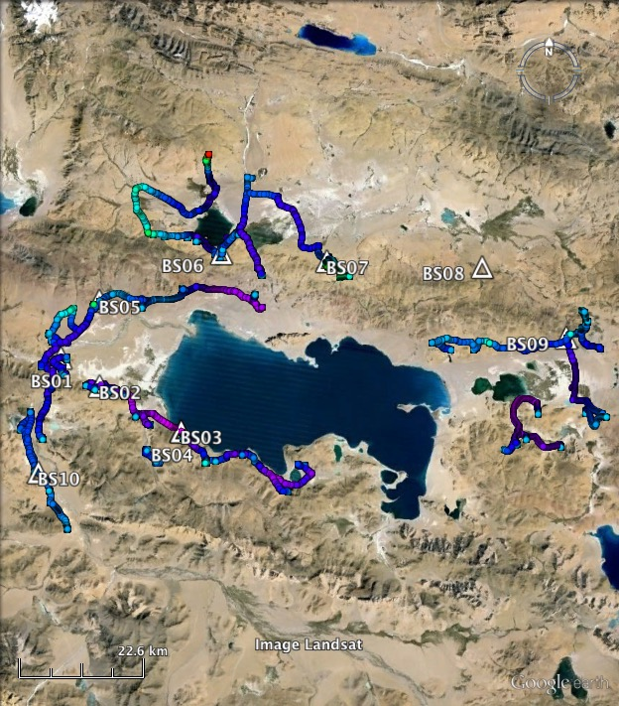
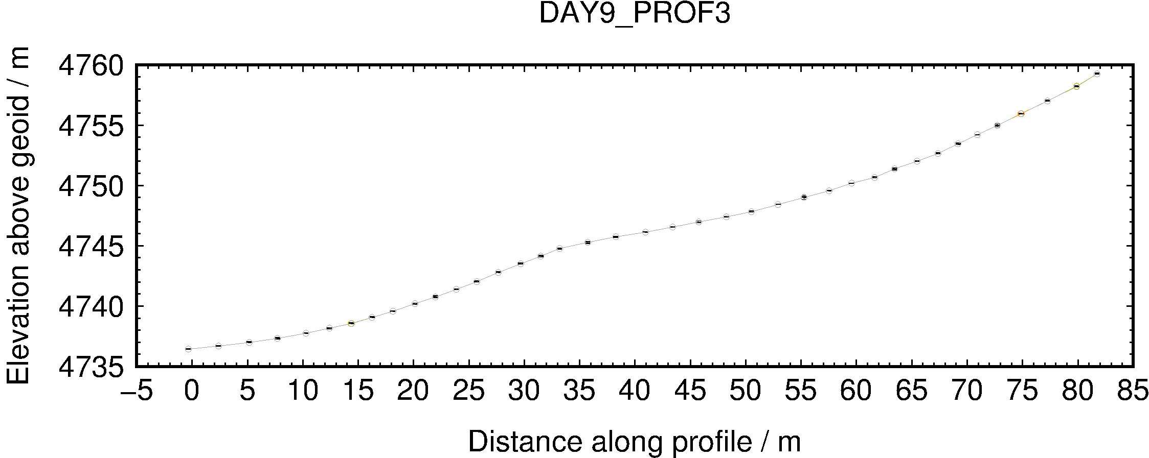
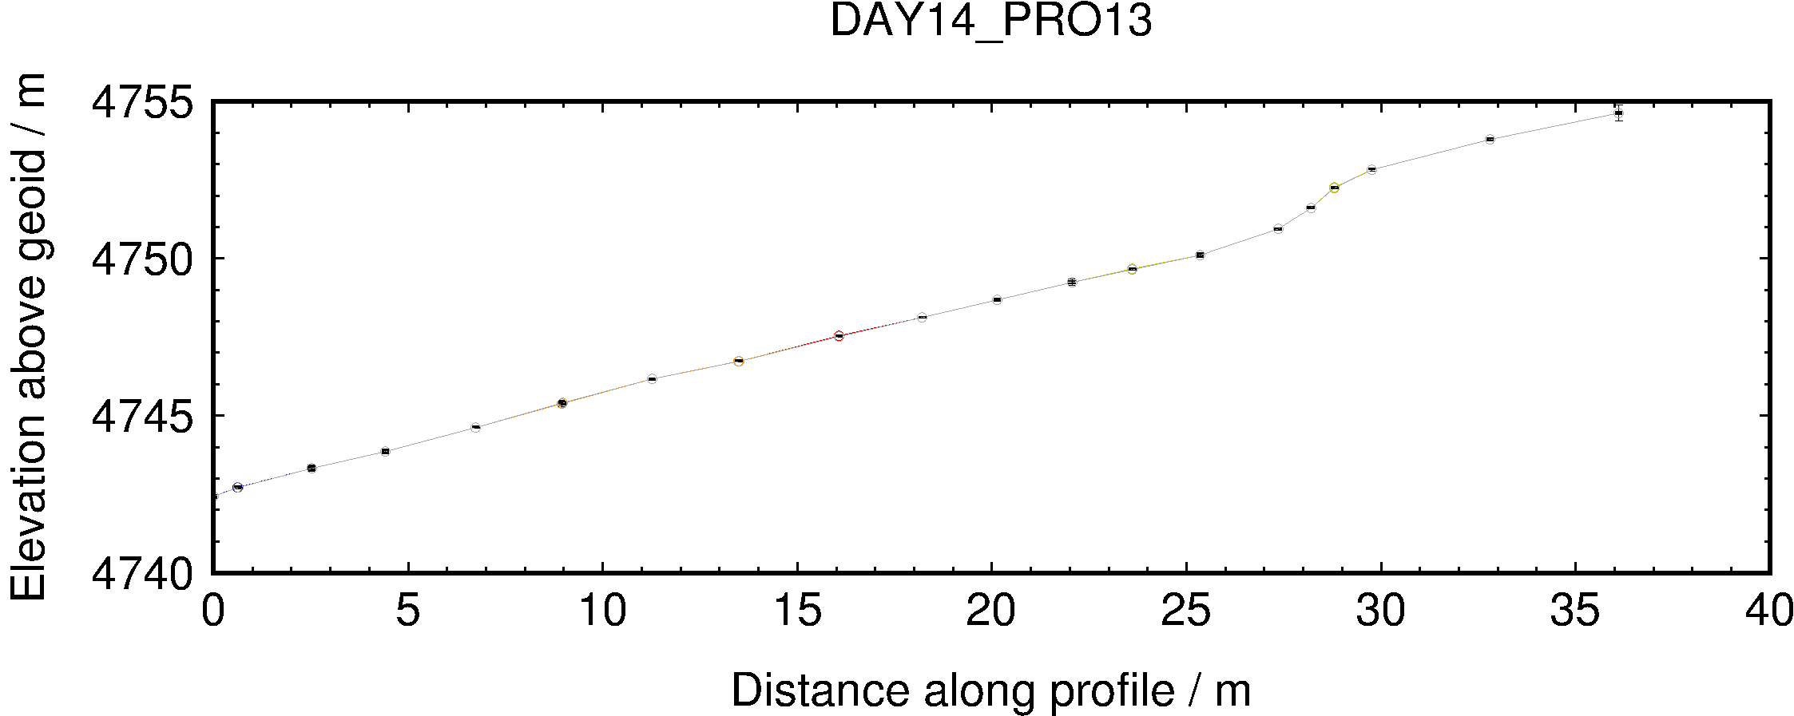
Example 2: Roving GPS
(from England et al., 2013)
Disclaimer: This example was not processed using TRACK because the kinematic equipment was single-frequency, i.e. L1-only, and TRACK requires dual-frequency data
Notes:
Roving GPS profiles traversing lake terraces allow us to determine the height and position of paleo-shorelines, here around lakes in southern Tibet (England et al., 2013). Static base stations are seen as triangles marked “BSnn”. The GPS receiver was left on while driving between localities in the field area (note 22.5 km scale bar in bottom left corner of left-hand figure), hence the long tracks (coloured by elevation). Specific high-resolution profiles and were taken on foot at many tens of locations, such as those seen in the right-hand figures. Ellipsoid heights converted to geoid heights using EGM2008 model (Pavlis et al., 2012).

Slide 16
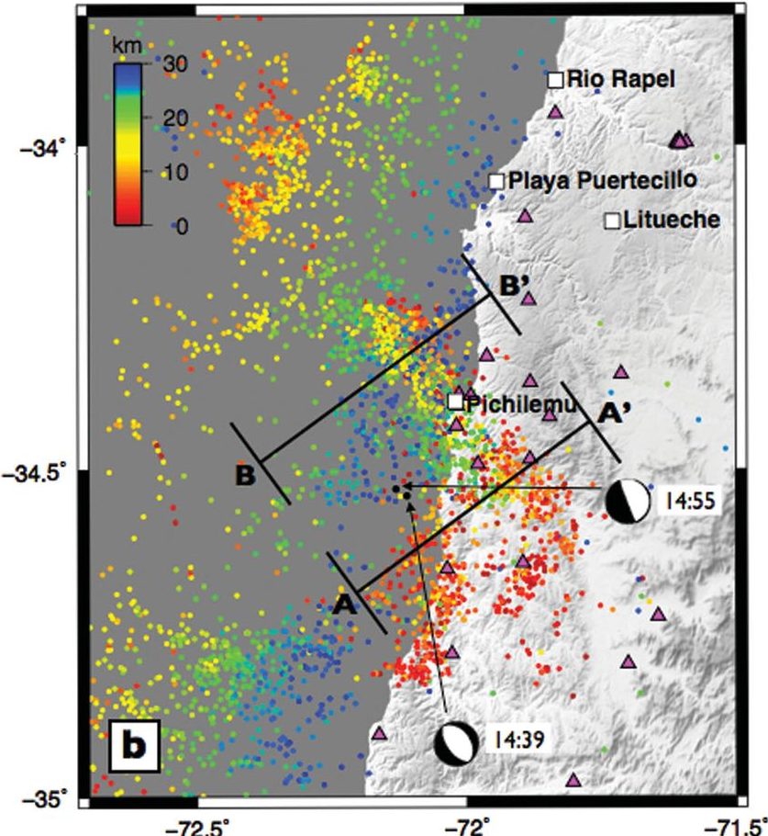
Example 3: Rapid deformation
(from Ryder et al., 2012)
Two earthquakes within 15 minutes of one another
InSAR shows cumulative deformation with no way to separate events
Epoch-by-epoch (rather than batch) GPS processing may help...
Ryder et al. (2012), Figure 1
Notes:
Two large (M_{w}6.9 and M_{w}6.7) aftershocks of the 2010-02-27 M_{w}8.8 Maule (Chile) earthquake occurred within 15 minutes of one another. An initial hypothesis was that they occurred on antithetic normal faults in the hanging wall of the subduction margin, as it extended in the aftermath of the megathrust mainshock, but InSAR data were ambiguous. Epoch-by-epoch GPS processing with TRACK resolved this ambiguity by demonstrating that a site (LEMU) moved in one direction (south-west and down) in the first aftershock and in the opposite direction (north-east and up) in the second. The conclusion is that the aftershocks occurred on synthetic normal faults and LEMU was, coincidentally, in between the ruptured faults, thereby being on the footwall of the first aftershock and on the hanging wall of the second. This is also supported by the InSAR data and modelling.

Slide 17
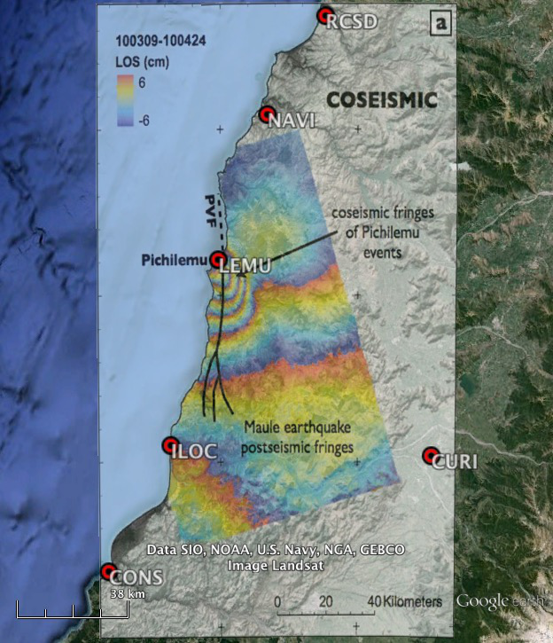
Example 3: Rapid deformation
(from Ryder et al., 2012)
Selecting fixed site:
CURI is
  Further from the main subduction earthquake
  Outside the deformation zone of the major aftershocks
  Along the nodal (zero deformation) plane of the major aftershocks
Ryder et al. (2012), Figure 3a
overlaid in Google Earth

Slide 18
Example 3: Preliminary run
Constrained first runs for ambiguities
Key track commands:
site_stats
iloc 10 10 10 0 0 0
lemu 10 10 10 0 0 0
navi 10 10 10 0 0 0
timedep_procns
iloc 1 1 1 2010 03 11 14 40 29 2010 03 11 14 40 30
lemu 1 1 1 2010 03 11 14 40 29 2010 03 11 14 40 30
navi 1 1 1 2010 03 11 14 40 29 2010 03 11 14 40 30
iloc 1 1 1 2010 03 11 14 55 59 2010 03 11 14 56 00
lemu 1 1 1 2010 03 11 14 55 59 2010 03 11 14 56 00
navi 1 1 1 2010 03 11 14 55 59 2010 03 11 14 56 00
Second run (updated apr):
site_stats
iloc 0.02 0.02 0.02 0 0 0
lemu 0.02 0.02 0.02 0 0 0
navi 0.02 0.02 0.02 0 0 0
timedep_procns
iloc 1 1 1 2010 03 11 14 40 29 2010 03 11 14 40 30
lemu 1 1 1 2010 03 11 14 40 29 2010 03 11 14 40 30
navi 1 1 1 2010 03 11 14 40 29 2010 03 11 14 40 30
iloc 1 1 1 2010 03 11 14 55 59 2010 03 11 14 56 00
lemu 1 1 1 2010 03 11 14 55 59 2010 03 11 14 56 00
navi 1 1 1 2010 03 11 14 55 59 2010 03 11 14 56 00
site_pos
...
N.B. Remember GPS is in GPS time, not UTC
Notes:
Two large (M_{w}6.9 and M_{w}6.7) aftershocks of the 2010-02-27 M_{w}8.8 Maule (Chile) earthquake occurred within 15 minutes of one another. An initial hypothesis was that they occurred on antithetic normal faults in the hanging wall of the subduction margin, as it extended in the aftermath of the megathrust mainshock, but InSAR data were ambiguous. Epoch-by-epoch GPS processing with TRACK resolved this ambiguity by demonstrating that a site (LEMU) moved in one direction (south-west and down) in the first aftershock and in the opposite direction (north-east and up) in the second. The conclusion is that the aftershocks occurred on synthetic normal faults and LEMU was, coincidentally, in between the ruptured faults, thereby being on the footwall of the first aftershock and on the hanging wall of the second. This is also supported by the InSAR data and modelling.

Slide 19
Example 3: Final run
Let the data freely define the noise
Read ambiguities from preliminary, constrained run, e.g
grep ‘FINAL’ sum-file > track.amb
Key track commands:
site_stats
iloc 10 10 10 1 1 1
lemu 10 10 10 1 1 1
navi 10 10 10 1 1 1
#timedep_procns
# iloc 1 1 1 2010 03 11 14 39 52 2010 03 11 14 40 00
# lemu 1 1 1 2010 03 11 14 39 52 2010 03 11 14 40 00
# navi 1 1 1 2010 03 11 14 39 52 2010 03 11 14 40 00
# iloc 1 1 1 2010 03 11 14 55 35 2010 03 11 14 56 00
# lemu 1 1 1 2010 03 11 14 55 35 2010 03 11 14 56 00
# navi 1 1 1 2010 03 11 14 55 35 2010 03 11 14 56 00
ambin_file track.amb
Notes:
Two large (M_{w}6.9 and M_{w}6.7) aftershocks of the 2010-02-27 M_{w}8.8 Maule (Chile) earthquake occurred within 15 minutes of one another. An initial hypothesis was that they occurred on antithetic normal faults in the hanging wall of the subduction margin, as it extended in the aftermath of the megathrust mainshock, but InSAR data were ambiguous. Epoch-by-epoch GPS processing with TRACK resolved this ambiguity by demonstrating that a site (LEMU) moved in one direction (south-west and down) in the first aftershock and in the opposite direction (north-east and up) in the second. The conclusion is that the aftershocks occurred on synthetic normal faults and LEMU was, coincidentally, in between the ruptured faults, thereby being on the footwall of the first aftershock and on the hanging wall of the second. This is also supported by the InSAR data and modelling.

Slide 20
Example 3: track alters perspective
Initial hypothesis
Final conclusion
Earthquakes took place on antithetic normal faults in the upper plate of subduction interface
But cGPS site LEMU experiences opposite vertical motion due to first and second earthquakes
LEMU is on the hanging wall of first earthquake and footwall of second
Therefore faults must be synthetic normal faults
LEMU
LEMU
Notes:
Two large (M_{w}6.9 and M_{w}6.7) aftershocks of the 2010-02-27 M_{w}8.8 Maule (Chile) earthquake occurred within 15 minutes of one another. An initial hypothesis was that they occurred on antithetic normal faults in the hanging wall of the subduction margin, as it extended in the aftermath of the megathrust mainshock, but InSAR data were ambiguous. Epoch-by-epoch GPS processing with TRACK resolved this ambiguity by demonstrating that a site (LEMU) moved in one direction (south-west and down) in the first aftershock and in the opposite direction (north-east and up) in the second. The conclusion is that the aftershocks occurred on synthetic normal faults and LEMU was, coincidentally, in between the ruptured faults, thereby being on the footwall of the first aftershock and on the hanging wall of the second. This is also supported by the InSAR data and modelling.

Slide 21
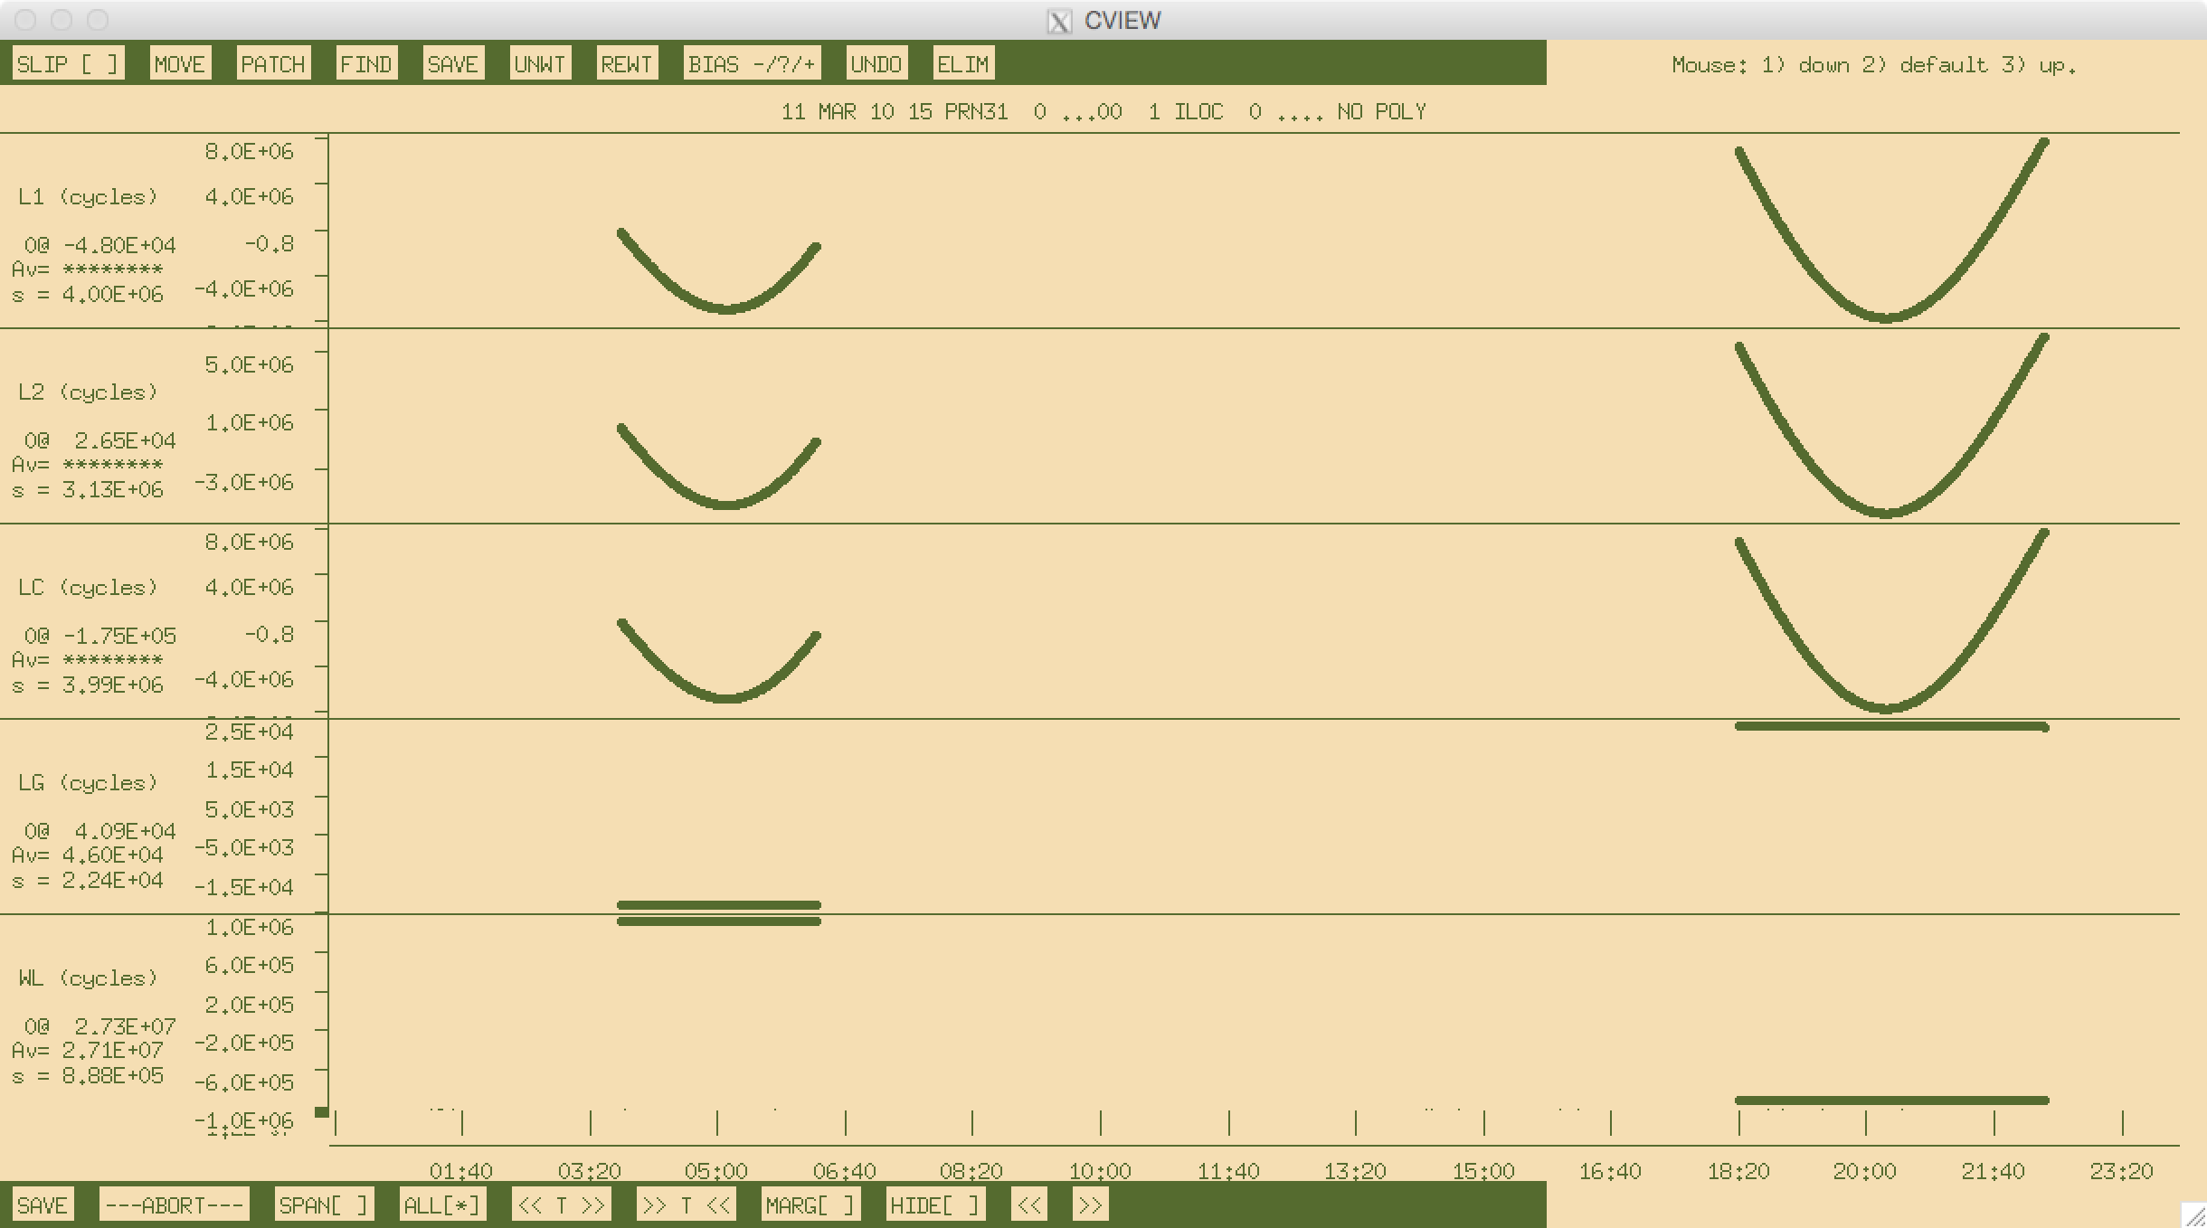
A good satellite in cview

Slide 22
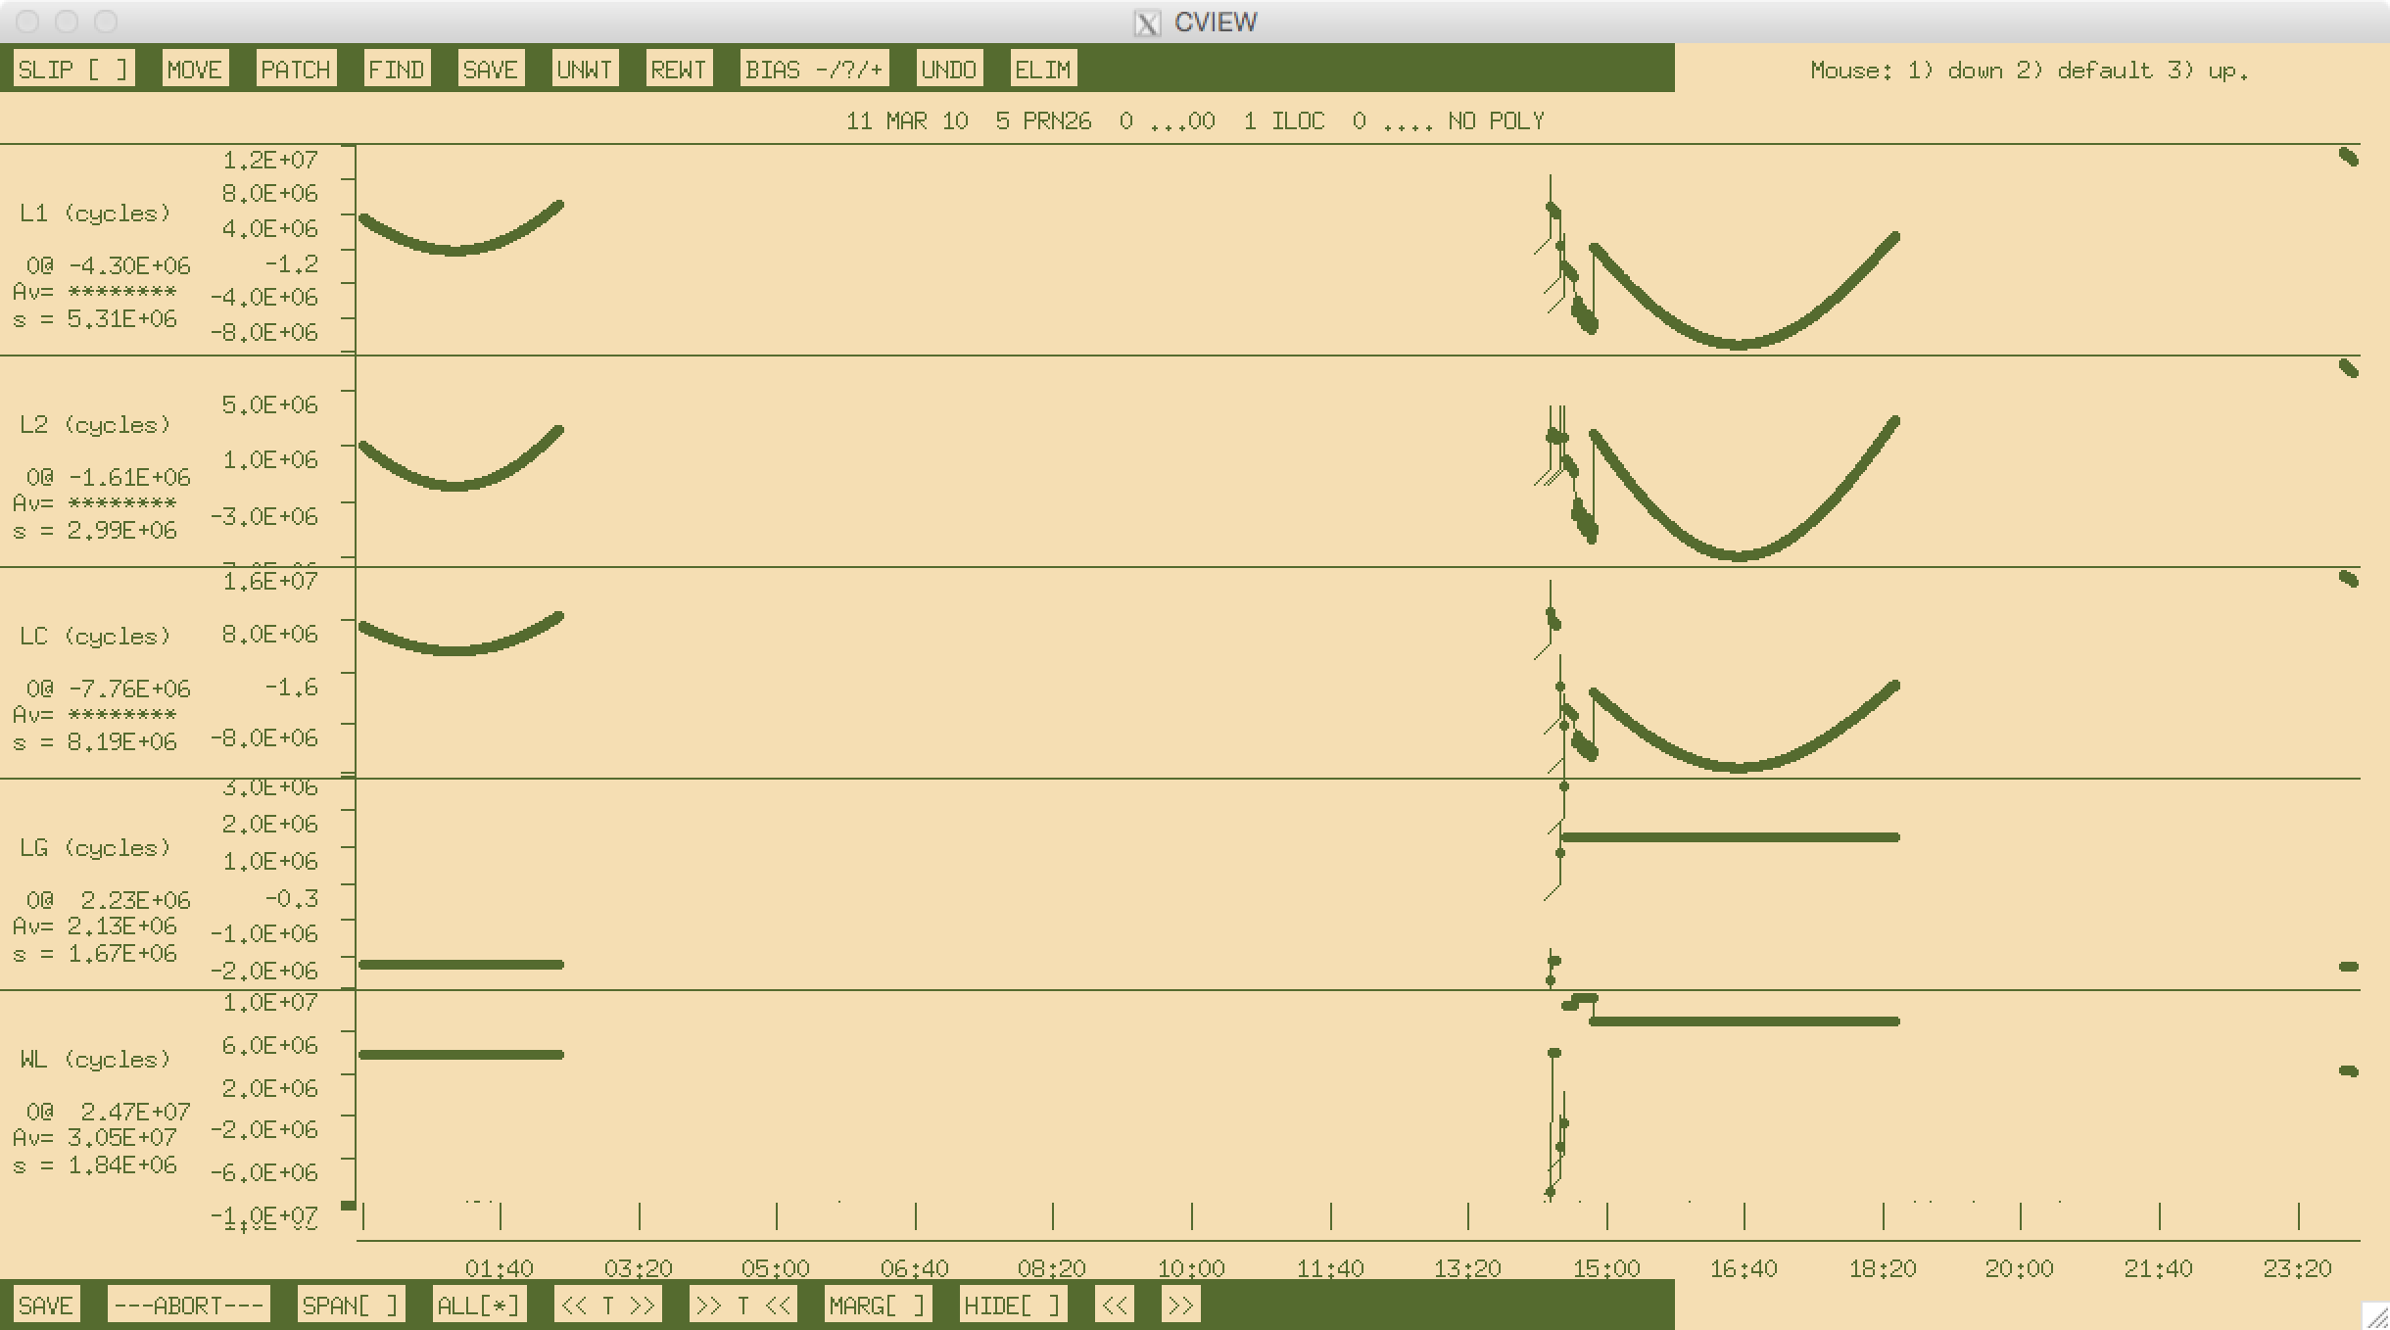
A satellite with some problems cview

Slide 23
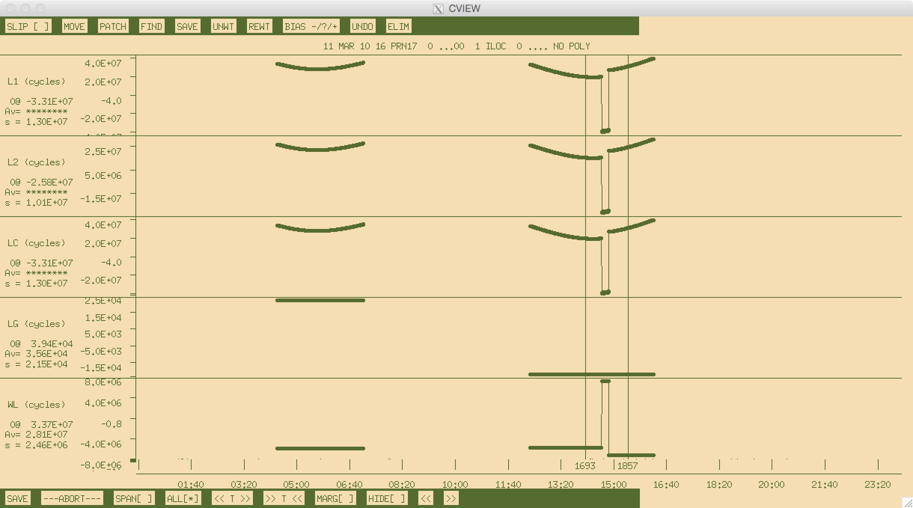
A problematic satellite in cview
Notes:
Next slide zooms in between lines.

Slide 24
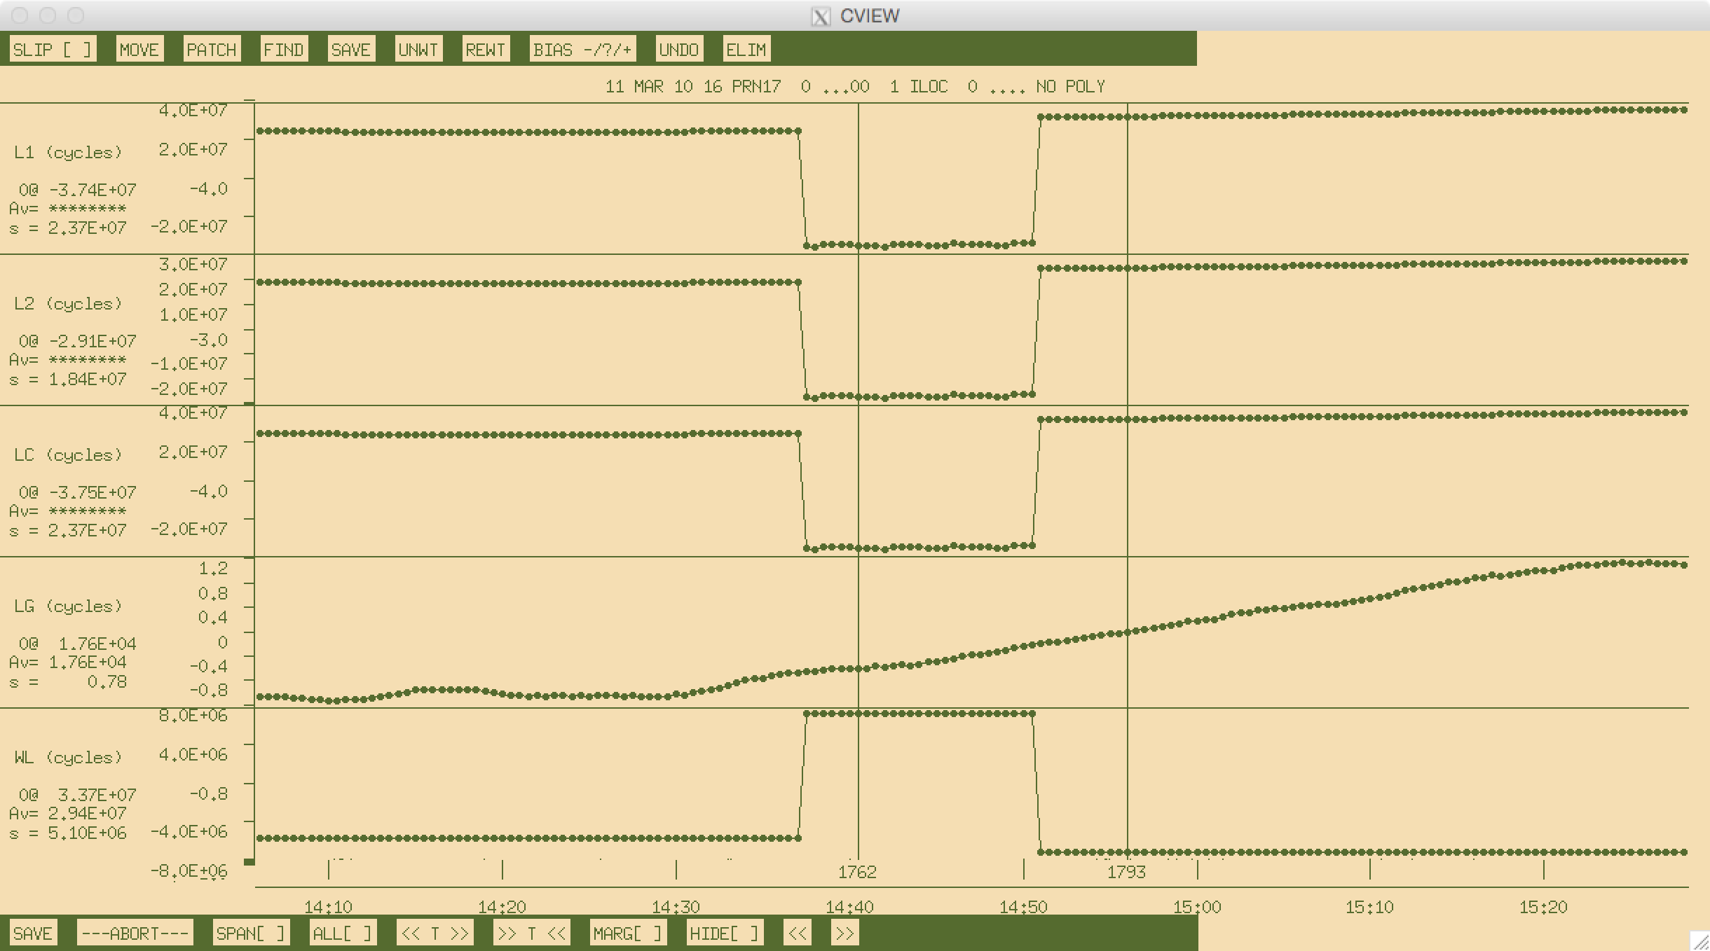
A problematic satellite in cview
usr_addbf iloc 17 2010 03 11 14 37 30
usr_addbf iloc 17 2010 03 11 14 51 00
Notes:
Lines are at the epochs of two earthquakes. Proximity of cycle slips to epochs of displacements makes it difficult for track to recognize (and resolve) the slips reliably?

Slide 25
Example 4: Episodic and continuous deformation
GAMIT/GLOBK processing
track processing
Process network of available data at nearby sites
Find candidate stable fixed site(s)
Ensure accurate coordinate coordinates for fixed site(s)
Use network of nearby, bedrock sites as base sites for kinematic processing of ice-flow
One fixed site natural but multiple constrained sites may provide redundancy
Ambiguities must still be resolved correctly

Slide 26
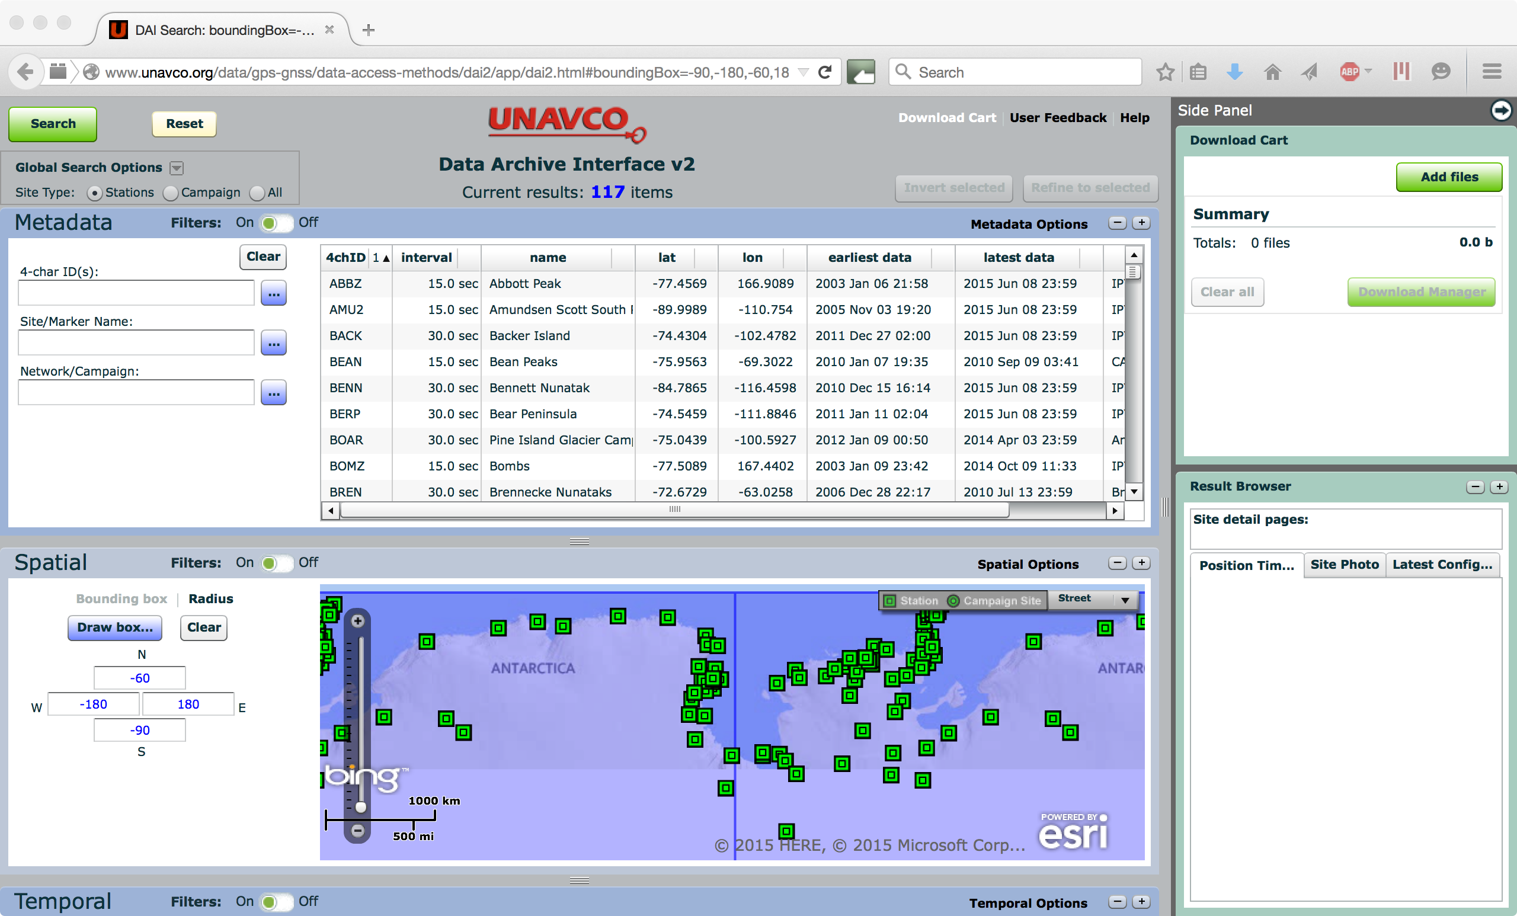
Building the static network
http://www.unavco.org/data/gps-gnss/data-access-methods/dai2/app/dai2.html

Slide 27
Ice flow or bedrock?

Slide 28
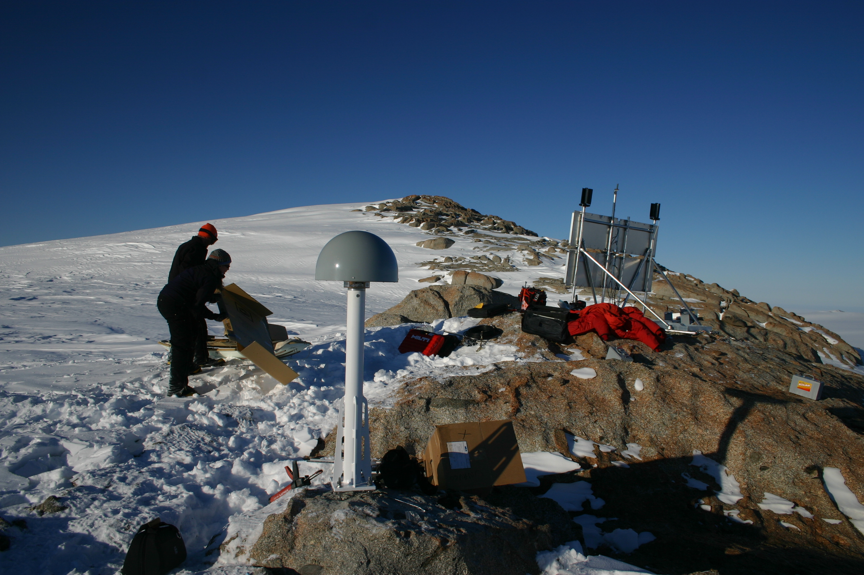
Ice flow or bedrock?

Slide 29
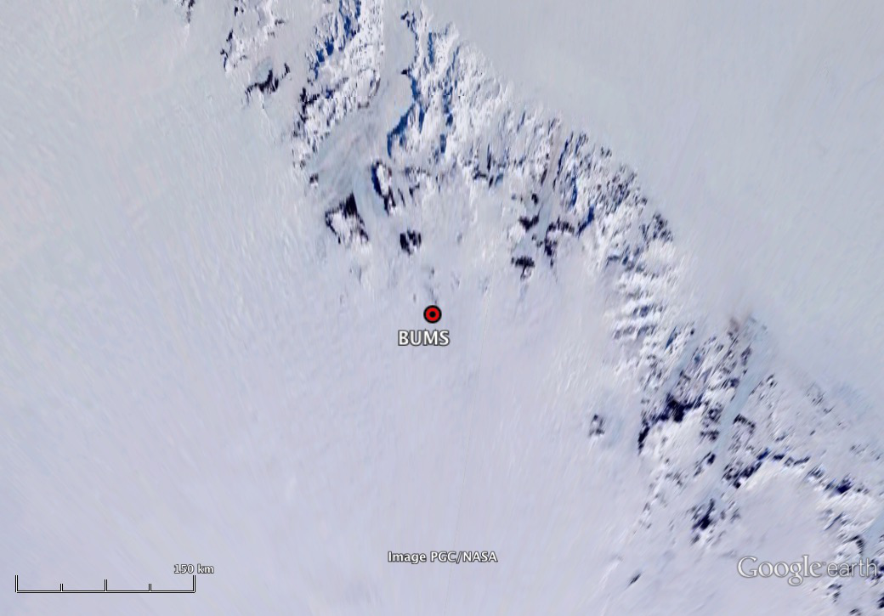
Ice flow or bedrock?

Slide 30
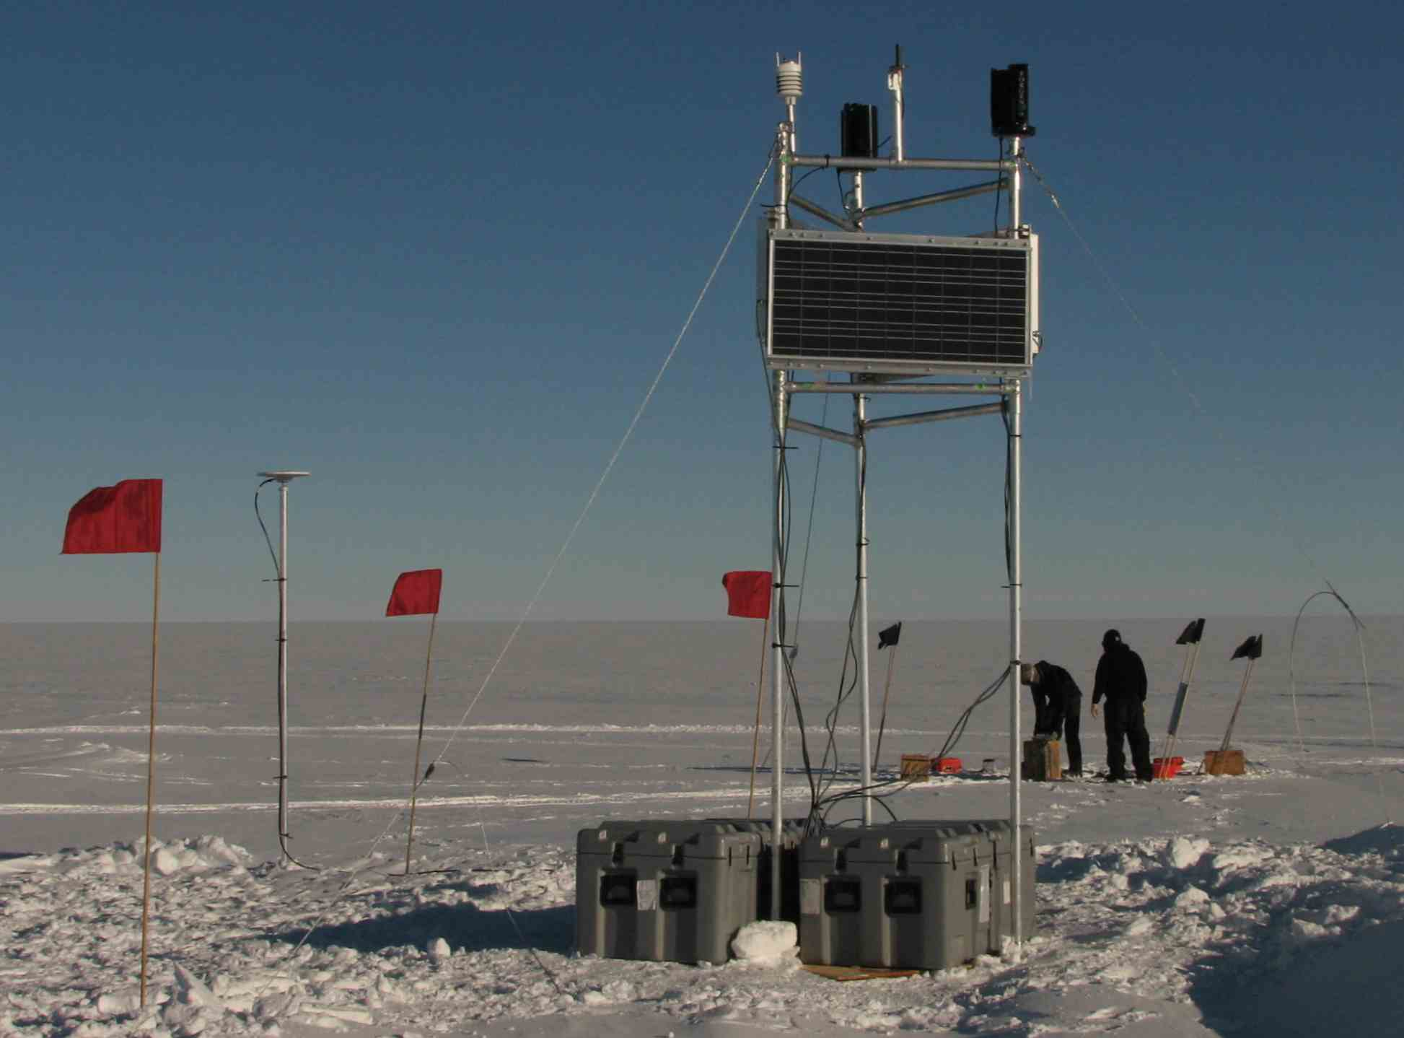
Ice flow or bedrock?

Slide 31
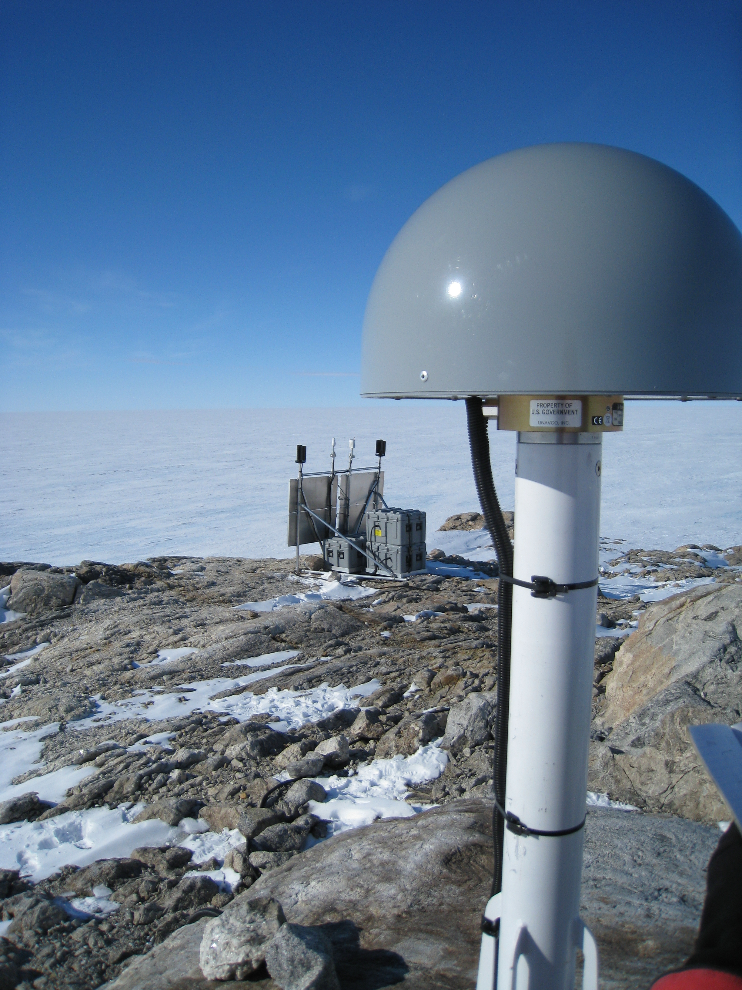
Ice flow or bedrock?

Slide 32
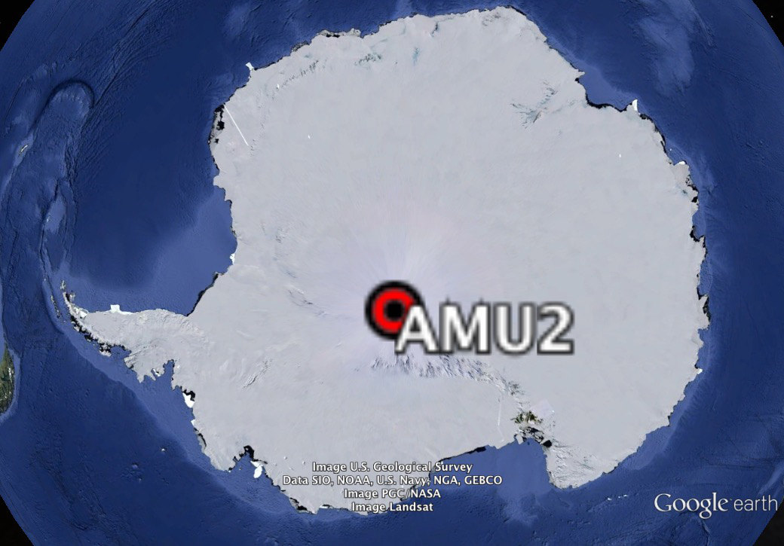
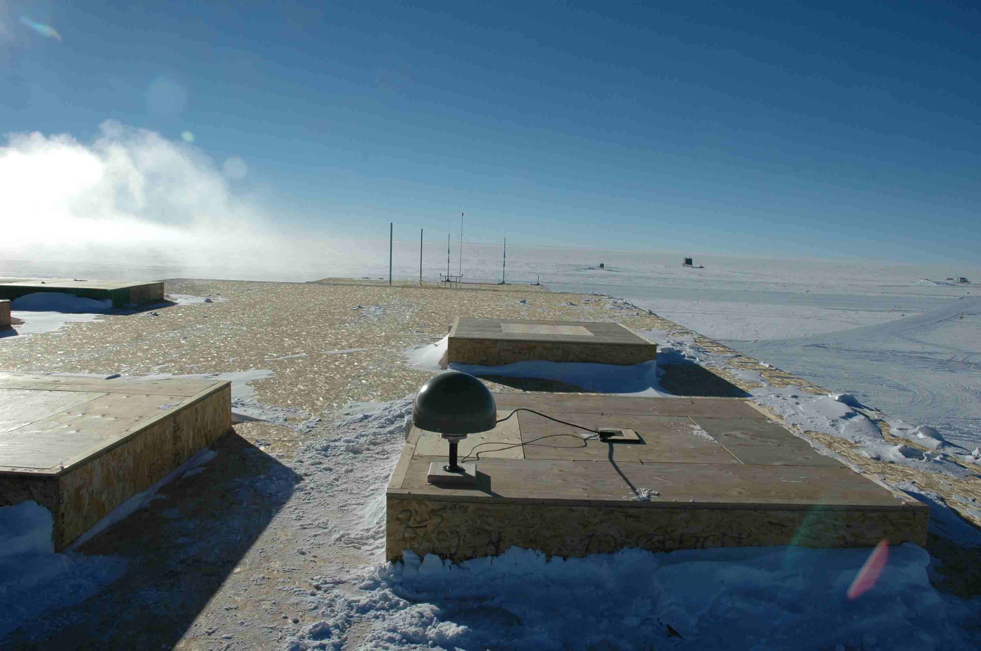
Ice flow or bedrock?
Notes:
Site is on roof of Amundsen-Scott South Pole Station. The thick ice sheet beneath moves and the building is capable of being adjusted to stay above accumulating snow.

Slide 33
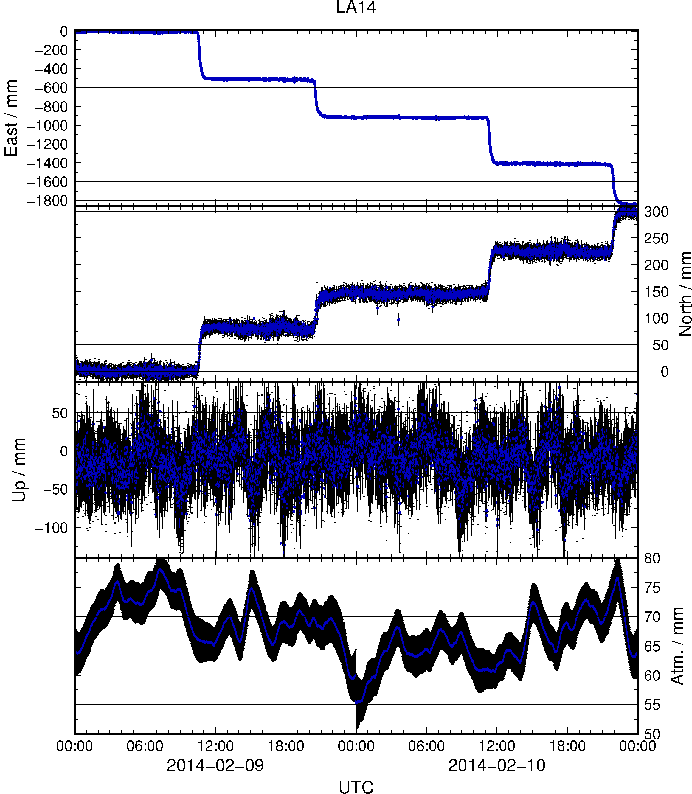
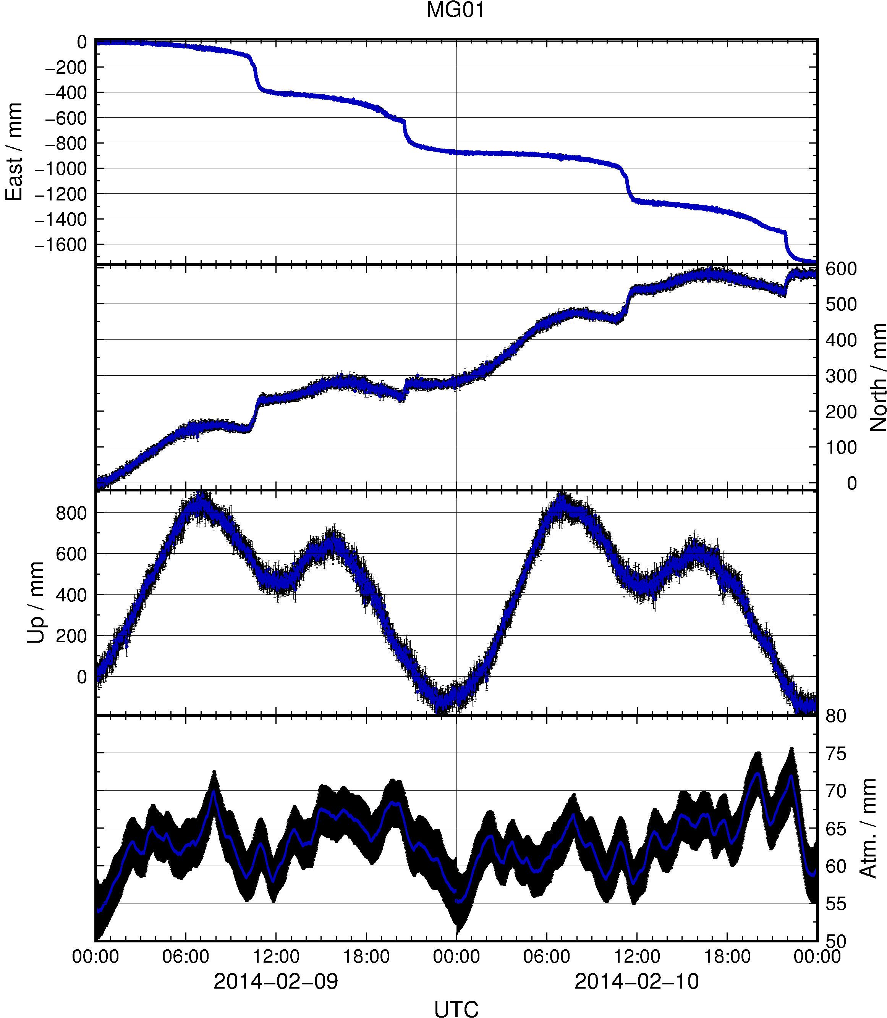
Kinematic results using FALL, RAMG and BUMS as fixed sites*
* FALL is the declared fixed site (“F” flag under “obs_file” option); RAMG and BUMS
are technically kinematic sites (“K” flag) but are constrained by zero process noise.

Slide 34
Experiment-specific constraints
Justification
Key track commands
We wish to apply our own temporal constraints (we have moving sites), so let’s be clear on units
Atmosphere is more stable in Antarctica (cold, high pressure)
  Evident in daily GAMIT processing “o”-files
Previous studies show maximum displacement rates of 0.5 m over 30 mins (but loosen temporal constraints for final solution with “ambin_file”)
time_unit second
atm_stats
FALL 0.1 0.0001 0
RAMG 0.1 0.0001 0
: : : :
site_stats
FALL 10 10 10 0 0 0
RAMG 10 10 10 0 0 0
: : : : : : :
LA14 10 10 10 0.1 0.1 0.1
MG01 10 10 10 0.1 0.1 0.1

Slide 35
Example 5: Short-static occupations
Rover
Short spans of data (e.g. 30 minutes) may be processed with GAMIT
Risk of all data being removed during cleaning (AUTCLN) if not high quality
track may be used in “short-static” approach with fixed, continuously recording and well positioned base site
Rover
Long session base site with accurate a priori coordinate calculated using GAMIT
Rover
Rover

Slide 36
Example 5: Short-static occupations
Notes:
Data from 2000 and 2001 are short-static occupations processed with track. All other data are regular geodetic occupations processed with GAMIT. Note the large outlier (incorrect ambiguity resolution?) at B245 in 2001.

Slide 37
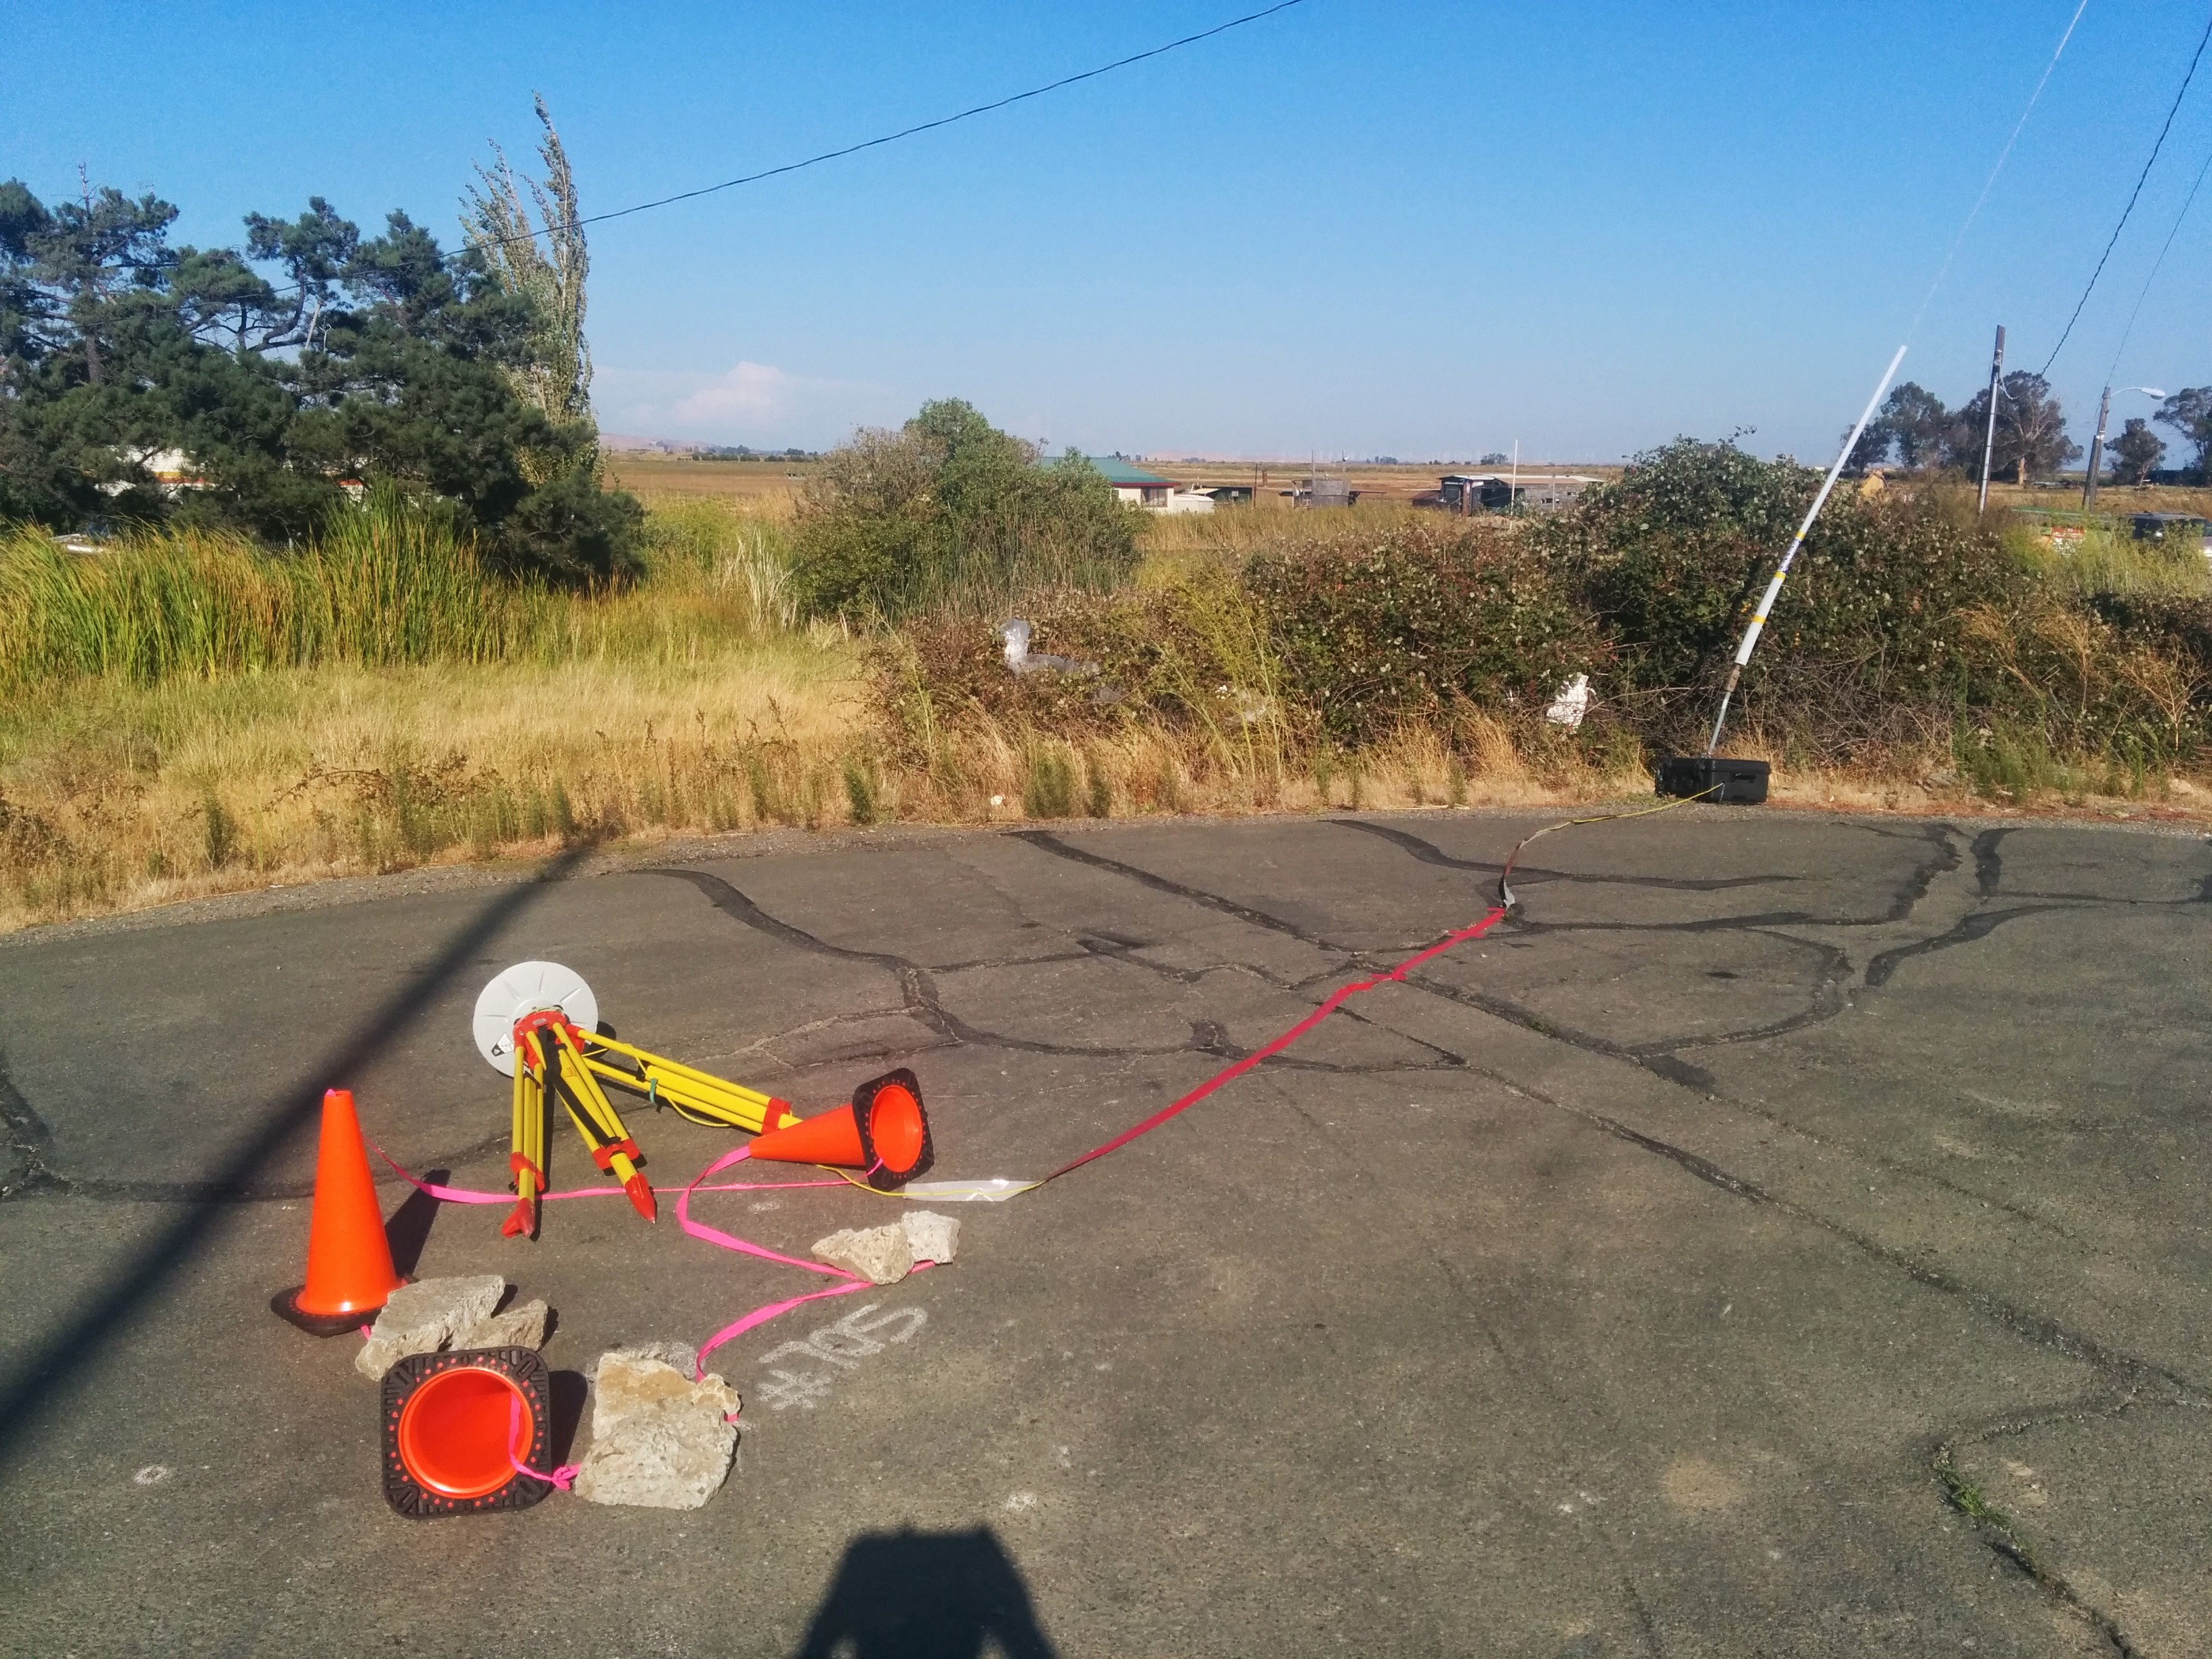
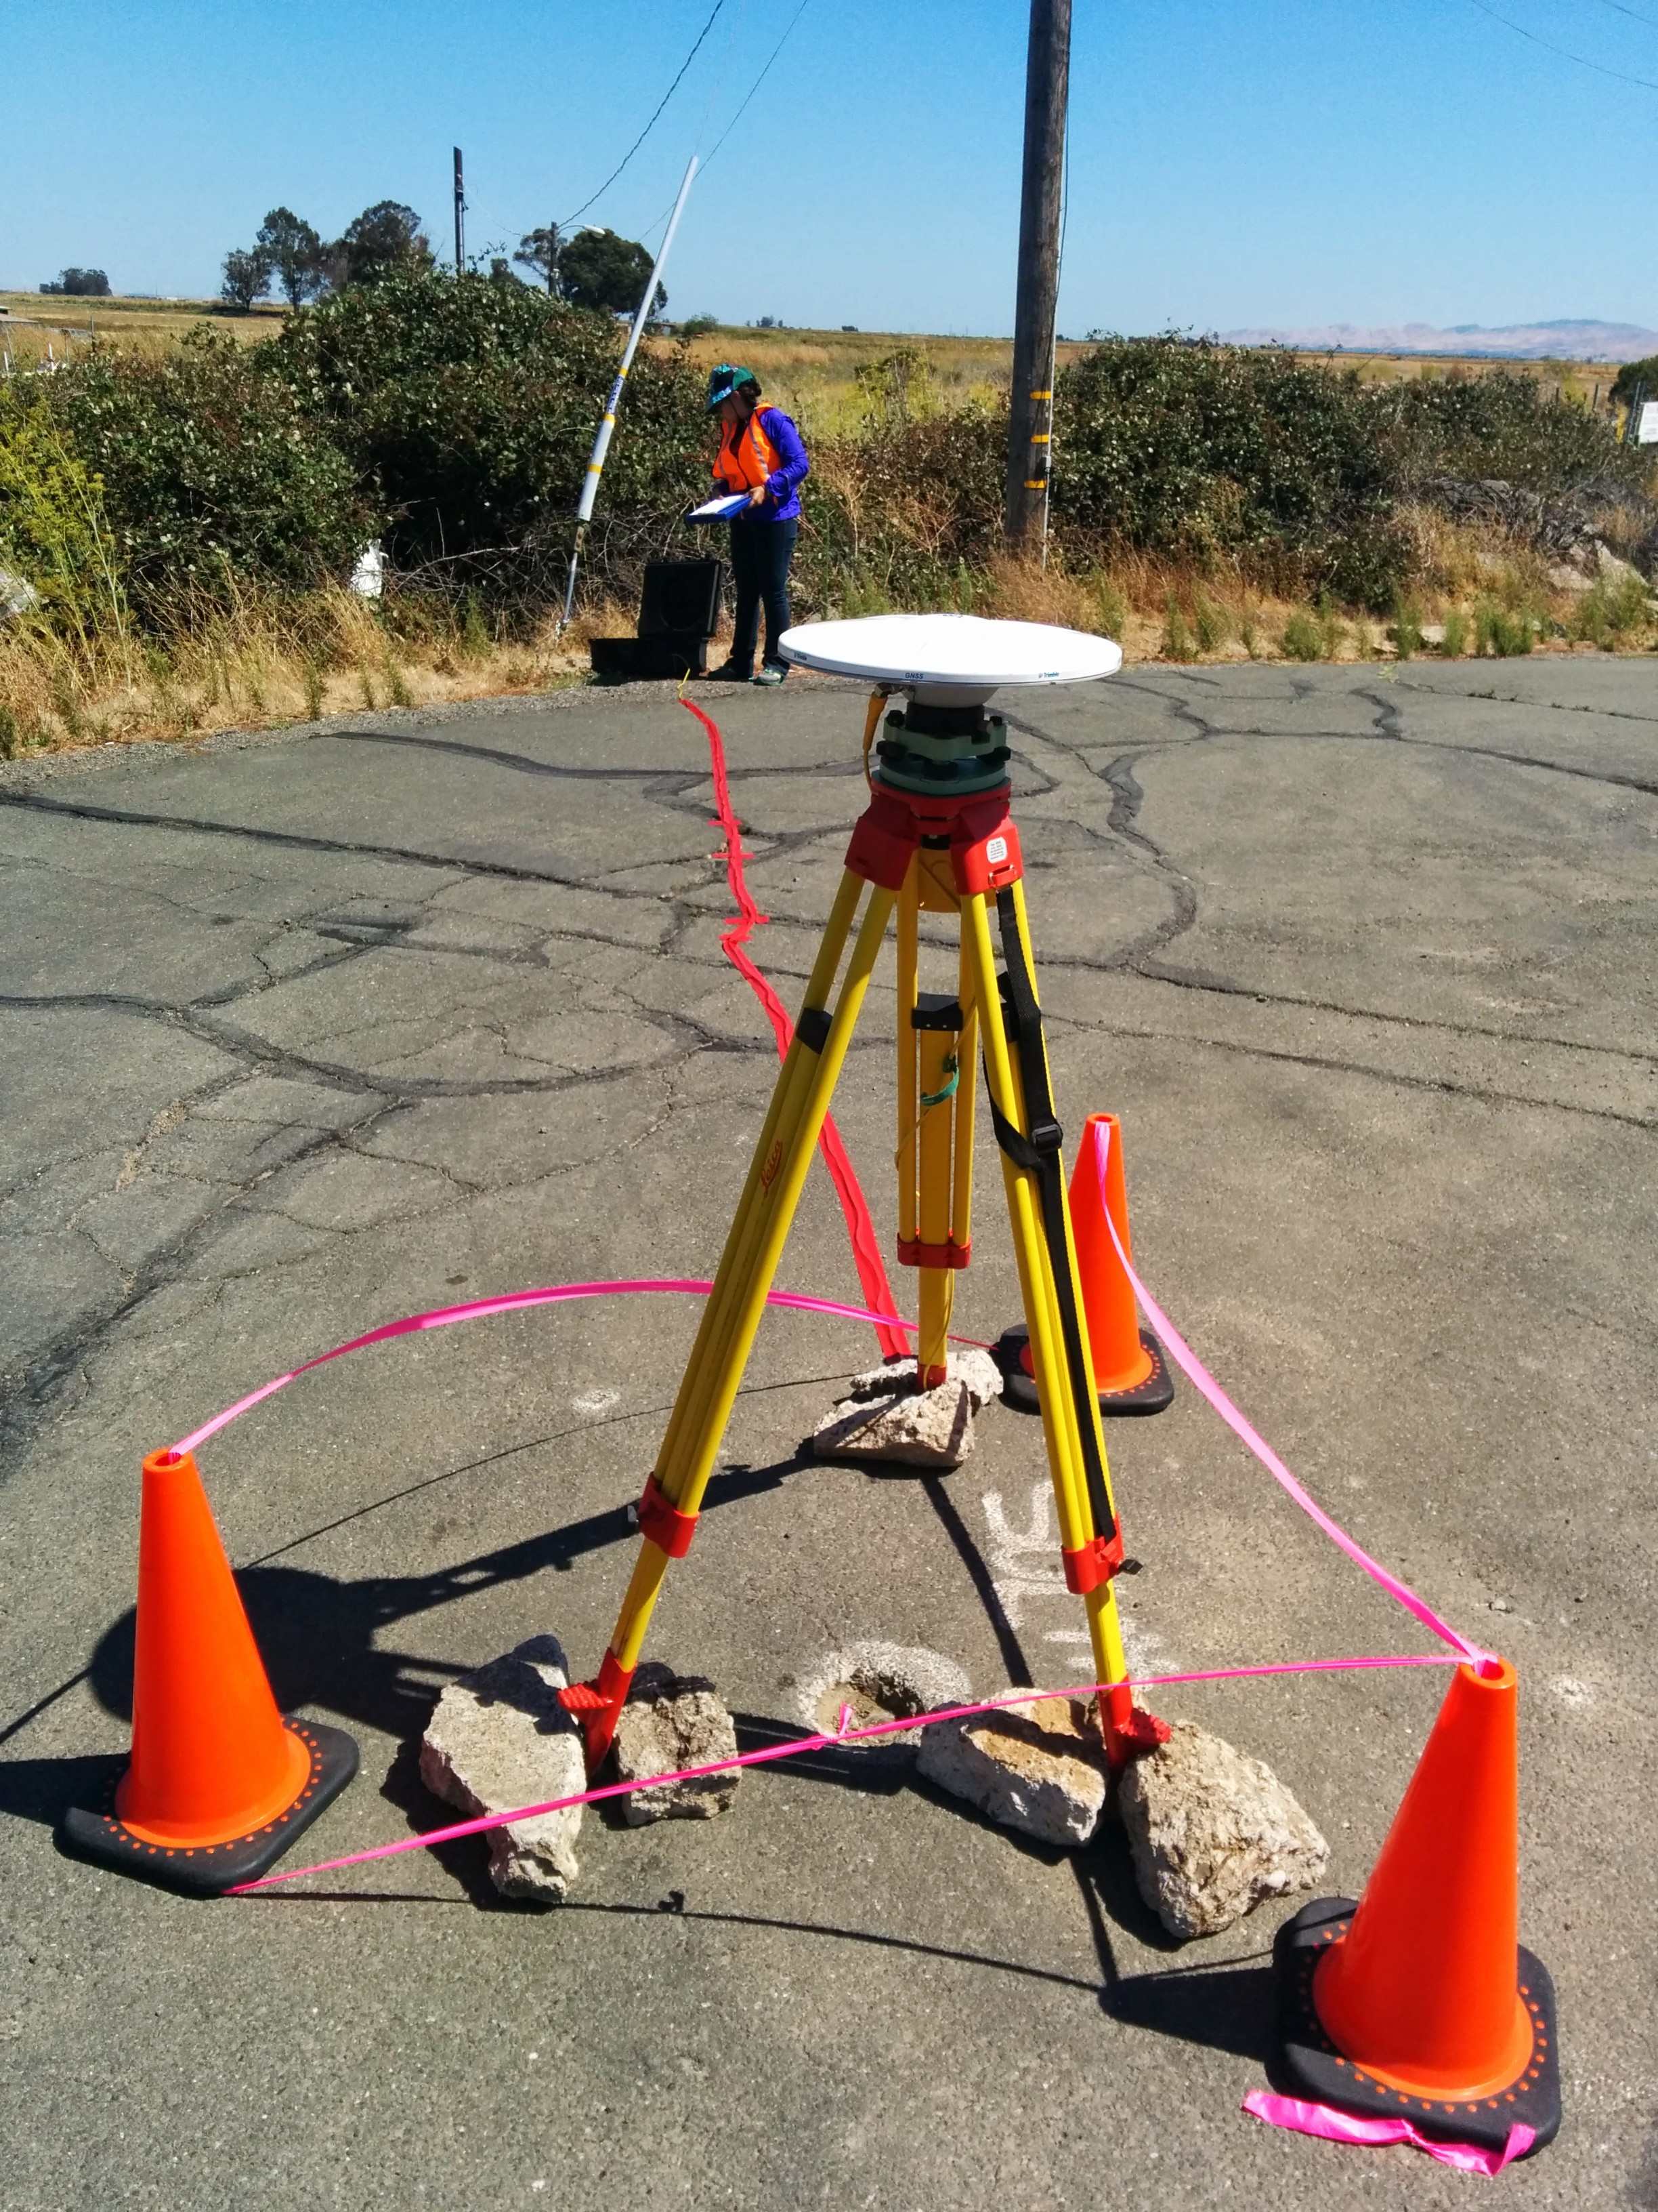
N
Sometimes, this happens…
1.2810 m
Photographs courtesy of Gareth Funning (University of California, Riverside)

Slide 38
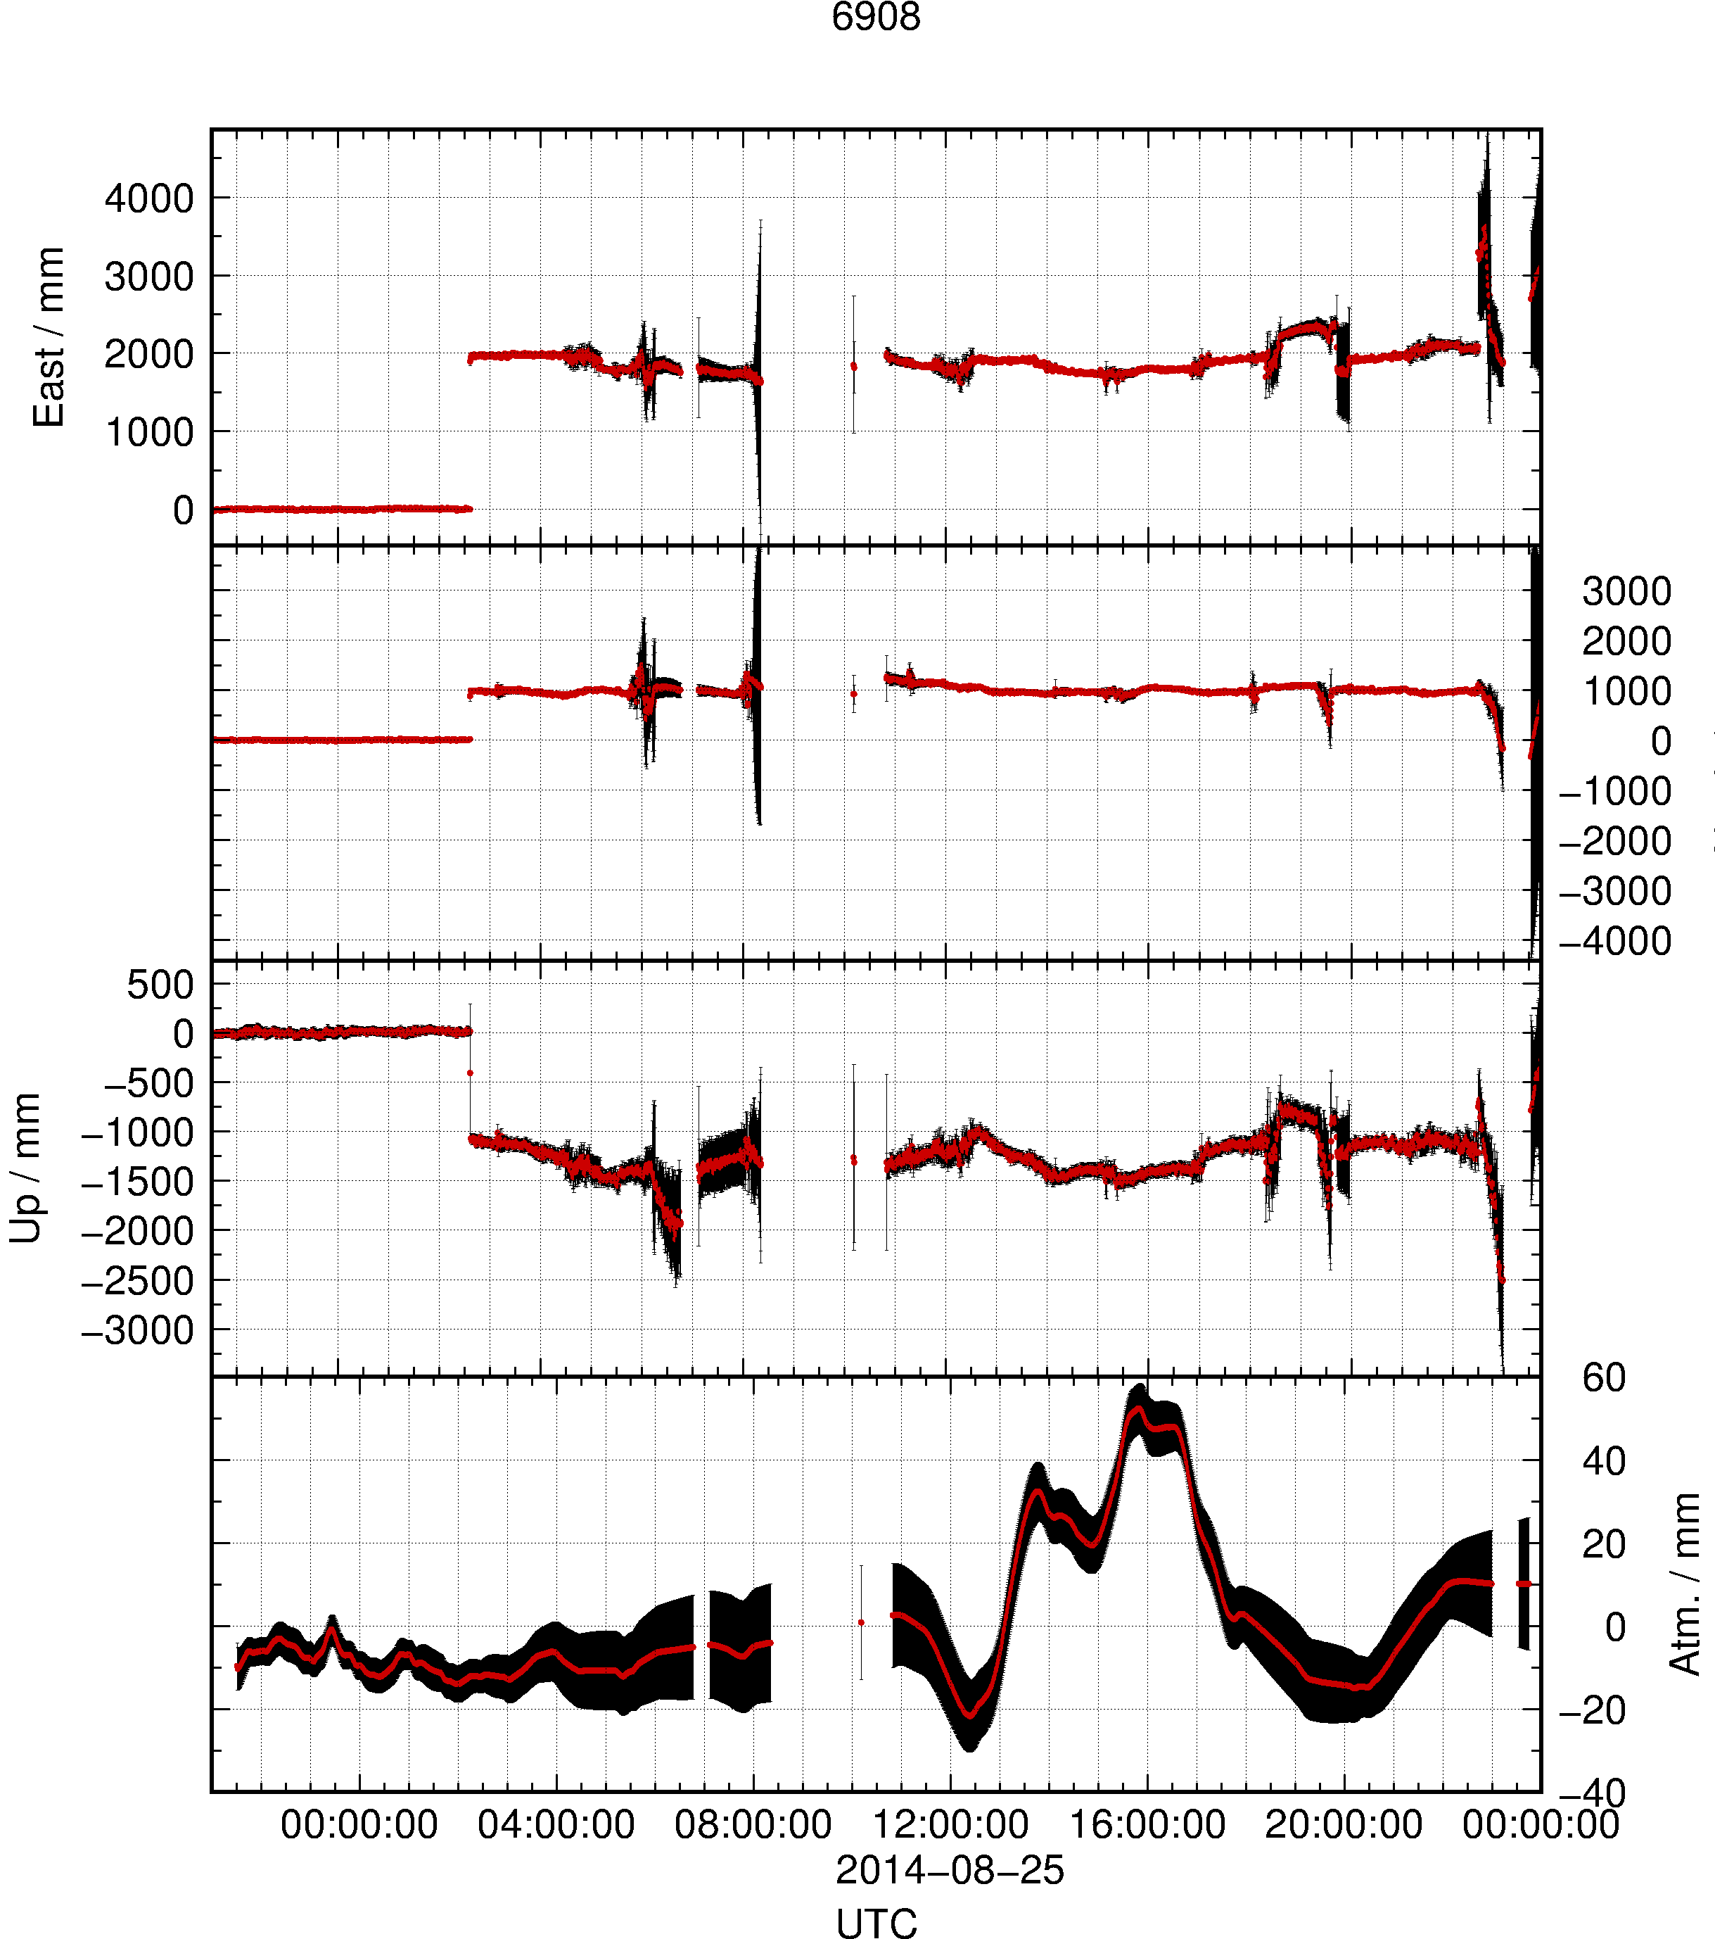
Example 6: Deciphering interference
Setup
First, run track with loose constraints to identify probable epoch of disturbance
Update a priori position and re-run track for solution
Re-run teqc with “-e” option to truncate RINEX file at epoch of disturbance so as not to propagate bad data
19:36
local time
Notes:
The tripod at the site pictured in the previous slide (6908, off I-680 south of Cordelia, CA) appears to have been knocked over or collapsed after 2014-08-25T02:36:30Z. This still leaves ~ 5 hours of “untouched” GPS data available for regular static processing, but anything after this epoch ideally should be discarded by truncating the RINEX file to avoid propagation of unusable data.

Slide 39
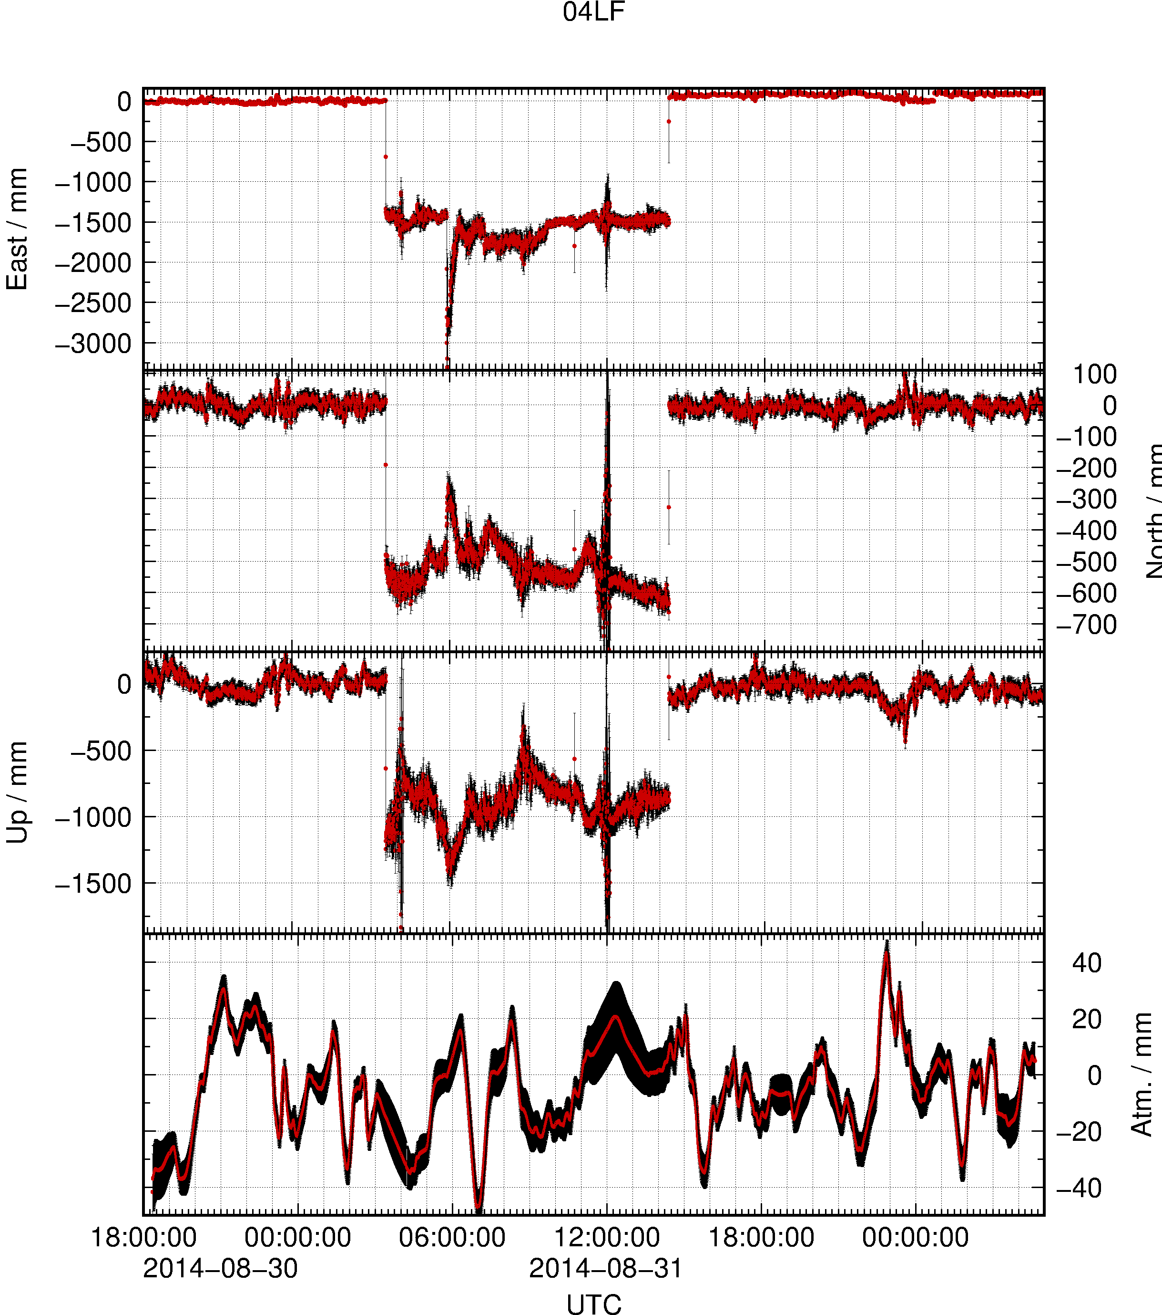
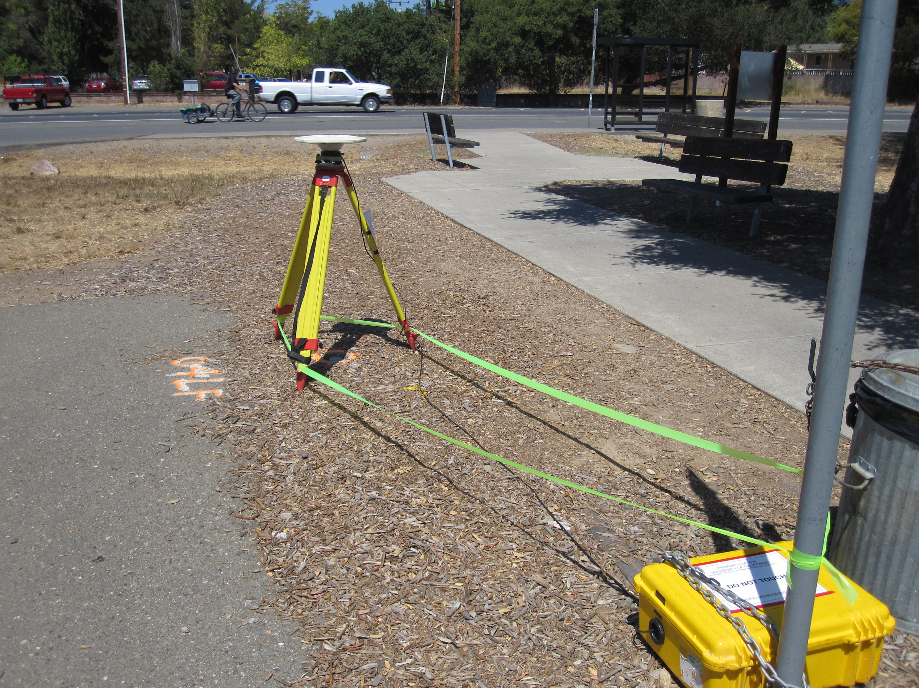
Example 6: A complex example
~ 9 hrs
???
1.0450 m
20:34
local time
07:21
local time
Notes:
This site, 04LF, is within Maxwell Farms Regional Park in Sonoma, California. The path to the right (east) of the site is used as a waiting area for children attending the local school when they get on or off the school bus at the stop in the background. This site is very exposed to public interference and the example here shows how, after 03:34:00 UTC (20:34:00 local time) on 2014-08-31, the site was disturbed. Apparently it is lying on the ground (du = ~ antenna height) a few m away from the mark. Then, after 14:21:30 UTC (07:21:30 local time) the next day, it is approximately (but not exactly) replaced over the mark. Ground truth measurements were taken when the antenna was retrieved showing the replaced tripod to be ~ 70 mm away from the mark on true azimuth ~ 050° at a height of 1.0063 m, 38.7 mm lower than before. While this data may be used with the ground-truthed differential position, it is safest to truncate the data (e.g. in the RINEX file) at 2014-08-31T03:34:00Z.

Slide 40
References
England, P. C., R. T. Walker, B. Fu and M. A. Floyd (2013), A bound on the viscosity of the Tibetan crust from the horizontality of palaeolake shorelines, Earth Planet. Sci. Lett., 375, 44–56, doi:10.1016/j.epsl.2013.05.001.
Ryder, I., A. Rietbrock, K. Kelson, R. Bürgmann, M. Floyd, A. Socquet, C. Vigny and D. Carrizo (2012), Large extensional aftershocks in the continental forearc triggered by the 2010 Maule earthquake, Chile, Geophys. J. Int., 188, 879–890, doi:10.1111/j.1365-246X.2011.05321.x.

