Slide 1


Reference frames
M. A. Floyd
Massachusetts Institute of Technology, Cambridge, MA, USA
GPS Data Processing and Analysis with GAMIT/GLOBK
Earth Observatory of Singapore
17–21 July 2017
http://geoweb.mit.edu/~floyd/courses/gg/201707_EOS/
Material from R. W. King, T. A. Herring, M. A. Floyd (MIT) and S. C. McClusky (now at ANU)

Slide 2
Reference systems
Mathematic idealization of geometry
Often what one refers to as a “datum”, e.g. for the whole Earth, WGS84
  Ellipsoid with
    Semi-major axis
    = 6,378,137.0 m
    Semi-minor axis
    = 6,356,752.314 245 m
    Inverse flattening
    = 298.257 223 563

Slide 3
Reference frames
Physical realization of reference system
Requires fixed measurement sites which are defined by position and velocity in the reference frame and thus constitute realizing the system
  VLBI
  SLR
  GPS

Slide 4
Ultimately, everything is relative
Even “absolute positioning” is relative to some coordinate origin, orientation and scale
So what is “global positioning”?
The center and rotation pole of Earth define our coordinate axes
  But how to we know where the center of the Earth is?
  Do we really care?
    It depends on your goals
No-net-rotation criterion (surface integral of angular velocity is zero) is usually used as the constraint on defining a terrestrial reference frame in the presence of surface motions (plate tectonics)

Slide 5
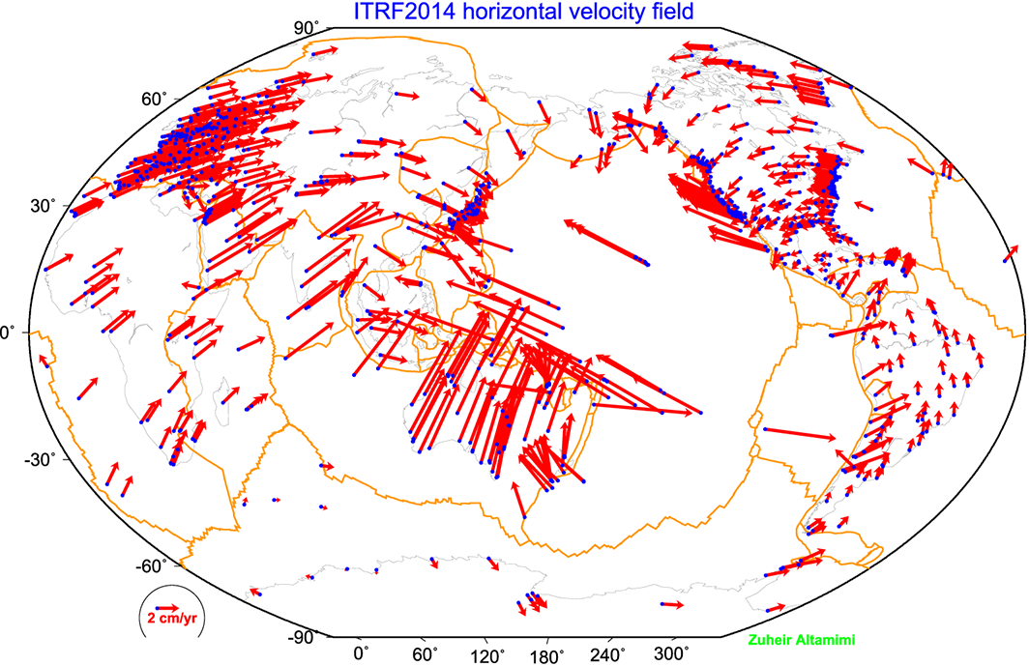
ITRF2014

Slide 6
ITRF2014
What are some general features of plate motion that you can see?
North America rotates around a point in the Pacific off South America
Eurasia and Africa appear to have very similar motions
Antarctica is moving very little

Slide 7
Choices of reference frame
Choose your reference frame based on your geophysical objectives
  Velocities in ITRF are difficult to interpret visually from a geophysical perspective
    Local surroundings of a volcano
    One side of a fault
    Upper plate of a subduction zone
Major plate reference frame
  Major plates are often chosen to conform with conventional perspectives of velocity solutions
  Relative to Eurasia, Nubia, North America, South America, etc.
  But don’t feel restricted by this. Sometimes your geophysical discussion is best visualized relative to any stable boundary of a deforming region
Regional reference frame
  Central Valley of California, non-deforming part of Anatolia, smaller coherent regions, etc.
Local reference frame
  Sites near but outside the influence of a volcano, geothermal field, etc.

Slide 8
Examples
Expressing velocities in ITRF is not very meaningful or useful when we want to look at the deformation at a plate boundary, e.g. the San Andreas Fault system
Better to look at velocities with one side “fixed” so we can see what the other side is doing relative to it
NA
PA
NA
PA

Slide 9
Basic issues in reference frame realization
Concept is to align the estimated site positions and possibly velocity to a set of well defined locations that have physical significance for the analysis being performed (e.g., PBO aligns to a realization of the North America plate based on ITRF2008)
glorg is the module which does this and computes the covariance matrix of the aligned solution in the reference frame chosen.
Transformation is often called an N-parameter Helmert transformation
  N = 3: translation only (could also be just rotation)
  N = 6: translation and rotation
  N = 7: translation, rotation and scale
In GLOBK analyses, you need to decide
  How many parameters (3/6/7)
  Sites to use to determine the parameters (sh_gen_stats)
  Values of the positions/velocities of the reference frame sites
  Weight to be given to heights in computing the transformation parameters (“cnd_hgtv” command; first two arguments for position and velocity)
Notes:
Dong D., T. A. Herring, and R. W. King, Estimating Regional Deformation from a Combination of Space and Terrestrial Geodetic Data, J. Geodesy, 72, 200–214, 1998.

Slide 10
Reference frame implementation
Any vector may be mapped from one coordinate system to another by the application of
  Translation (affects position of co-ordinate origin)
  Rotation (affects orientation of co-ordinate axes)
  Scale (affects length of co-ordinate axes and maps into heights in the network)

Slide 11
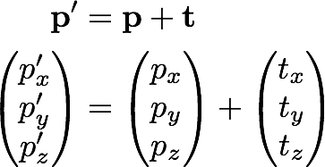
1: Translation

Slide 12
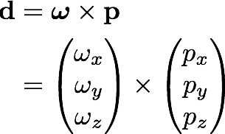
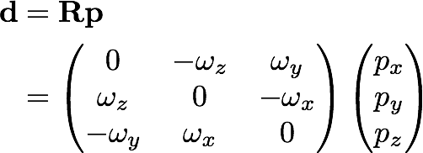
2: Rotation
Rotation vector, ω, is defined as in the direction of the rotation axis with length equal to the magnitude of angular rotation
Displacement (or velocity) vector then makes a right-handed triplet with the rotation vector, ω, and radial vector, p.

Slide 13
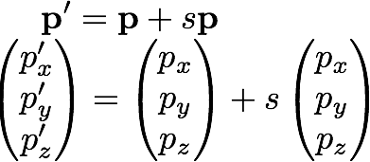
3: Scale
Scale estimation has a direct effect on the average height adjustments in the network so be cautious if your interested in height changes over the region of your reference frame definition.

Slide 14
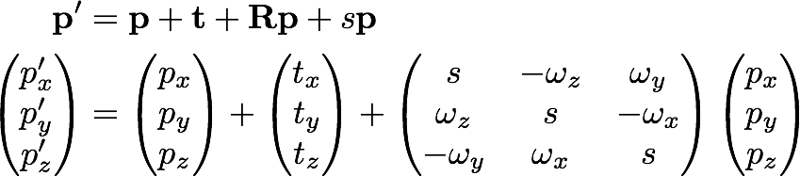
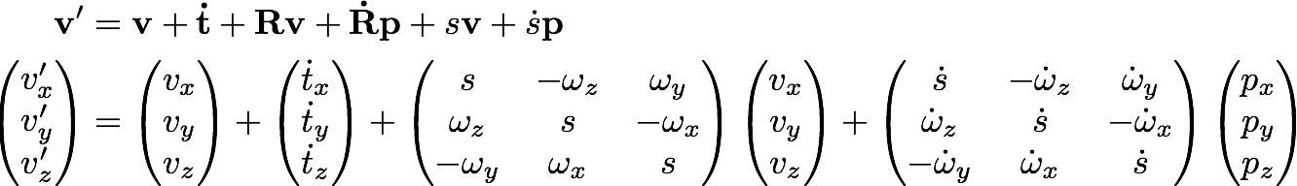
Helmert transformation
Position
Velocity
Usually, the terms Rv and sv are very small and can be neglected (< 10⁻⁶ rad × < 0.1 m/yr and < 0.1 ppb × < 0.1 m/yr, respectively)

Slide 15
What does “with respect to” mean?
Horizontal motions are restricted to the surface of the Earth, therefore the Helmert transformation may not contain translation or scaling of position terms
Set v’ to zero for all sites that you wish to estimate all other velocities with respect to
Estimate the best-fit transformation parameters, e.g. by least squares estimation, to achieve this minimization of velocities in a region
Apply the estimated transformation to all velocities
All velocities are now “with respect to” or “relative to” chosen subset
The subset could be, for instance, all on one tectonic plate, or any given region from which you wish to see the deformation

Slide 16
Reference frames in geodetic analyses
Output from GAMIT
  Loosely constrained solutions
  Relative position well determined, “absolute” position weakly defined
  Need a procedure to expressed coordinates in a well defined reference frame
Two aspects
  Theoretical (e.g. rigid block, mantle-fixed, no-net-rotation of plates)
  Realization through a set of coordinates and velocities
    “Finite constraints”: a priori sigmas on site coordinates
    “Generalized constraints”: minimize coordinate residuals while adjusting translation, rotation, and scale parameters
Three considerations in data processing and analysis
  Consistent with GPS orbits and EOP (NNR)
    not an issue if network small or if orbits and EOP estimated
  Physically meaningful frame in which to visualize site motions
  Robust realization for velocities and/or time series
Notes:
The key point here is that maintaining a consistent frame in your velocity solution but particularly in your time series, is important for getting a geodetic robust result, the manner by which this done and the frame in which it is realized need not be the frame of primary physical interest. The maintenance of a consistent frame is what we accomplish through “stabilization” in glorg. Relating this frame to a plate or block can be done afterward with a different set of sites.

Slide 17
Frame definition with finite constraints
Applied in globk (glorg not called)
We do not recommend this approach since it is sensitive to over-constraints that can distort velocities and positions
Example:
  apr_file itrf08.apr
  apr_neu all 10 10 10 1 1 1
  apr_neu algo .005 005 .010 .001 .001 .003
  apr_neu pie1 .002 005 .010 .001 .001 .003
  apr_neu drao .005 005 .010 .002 .002 .005
  ...
Most useful when only one or two reference sites or very local area
Disadvantage for large networks is that bad a priori coordinates or bad data from a reference site can distort the network

Slide 18
Frame definition with generalized constraints
Applied in glorg: minimize residuals of
reference sites while estimating
translation, rotation, and/or scale (3–7
parameters)
  apr_file itrf08.apr
  pos_org xtran ytran ztran xrot yrot zrot
  stab_site algo pie1 drao ...
  cnd_hgtv 10 10 0.8 3.
  stab_it 4 0.5 2.5
All reference coordinates free to adjust (anomalies more apparent), outliers are iteratively removed by glorg
Network can translate and rotate but not distort
Works best with strong redundancy (number and [if rotation] geometry of coordinates exceeds number of parameters)
Notes:
This is the preferred method. Must be careful due to glorg’s iterative removal or poorly fitting sites that the ultimate solution still has enough redundancy and stabilization power. Look through first hundred lines or so of . Can change statistics in cnd_hgtv and stab_it to control .

Slide 19
Defining a reference frame with glorg
Create an apr-file for use by glorg
  Apply known rotation rate to apr-file (e.g. itrf08_comb.apr → itrf08_comb_eura.apr)
  Zero velocity apr-file records (and iterate using sh_exglk to create updated apr-file)
Define set of sites (must be included in GAMIT processing or other H-file input to GLOBK) which define stable region
  plate in glorg command file

Slide 20
Stabilization using a global set of sites
Use 40 or more sites with good velocities determined in the ITRF frame
The itrf08_comb.apr file, when used together with itrf08_comb.eq to account consistently for instrumental changes over time, provides the widest choice of sites, 1992–2013
Combining your solution with the MIT or SOPAC global h-files offer access to over 100 sites without having to include them in your GAMIT processing.
  You need just 4–6 common sites, which should be of high quality but need not be well know in ITRF2008 since these “tie” sites do not need to be in your frame-realization list
For global ITRF stabilization, you can use the hierarchical list igb08_hierarchy.stab_site in gg/tables
Although a global frame may be a convenient way to do the stabilization, it is usually not necessary for regional studies.
Notes:
The “hierarchy” feature of the stab_site list allows you to specify alternative sites in each geography region, depending on which sites are available.

Slide 21
Use of global binary h-files
Include global h-files … or not?
  For post-2000 data, not needed for orbits
Advantages
  Access to a large number of sites for frame definition
  Can (should) allow adjustment to orbits and EOP
  Eases computational burden
Disadvantages
  Must use (mostly) the same models as the global processing
  Orbits implied by the global data worse than IGSF. Once-per-revolution radiation model parameters (loose in global h-files) should be treated carefully.
  Some bad data may be included in global h-files (can remove)
  Greater data storage burden
MIT hfiles available at ftp://everest.mit.edu/pub/MIT_GLL/HYY
When using MIT files, add “apr_svant all F F F” to globk command file to fix the satellite antenna offsets

Slide 22
Stabilization using regional or local sites
If your area of study has a robust cGPS network (10 or more well-distributed sites) with accurate a priori velocities, then glorg stabilization is robust and little thought is involved (glorg will automatically discard the one or two sites which may be weak or inconsistent)
If your region is short on cGPS stations with well-known coordinates, you will need to think carefully about the choice of sites to include in your solution and use the initial stabilization. A stabilization site should have
  High quality data over the full span of your study
  Coordinates well-known in ITRF
  Provide symmetric coverage around your study area (except that if the region is small enough, a translation-only stabilization may be possible and distribution is less important)

Slide 23
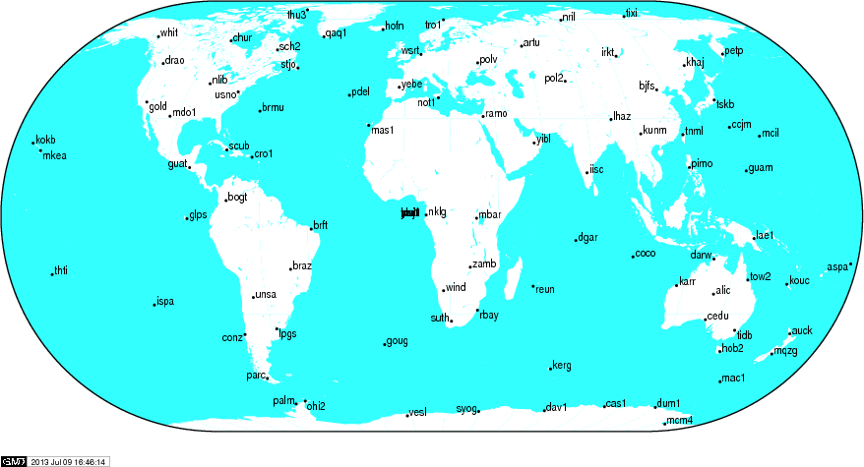
IGS (IGb08) reference frame core network
CHUR
DRAO
GOLD
GUAT
KOKB
MDO1
MKEA
NLIB
PETP
SCH2
SCUB
STJO
USNO
WHIT
http://igscb.jpl.nasa.gov/network/refframe_core.html
Notes:
When selecting sites to process with your local data of interest, look first to include sites from the IGS core network.

Slide 24
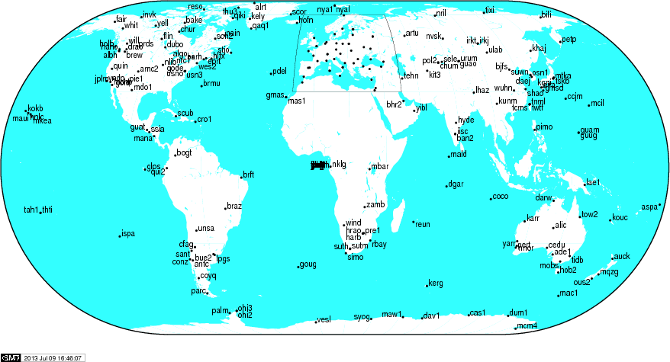
IGS (IGb08) reference frame network
JPLM
PIE1
QUIN
VNDP
http://igscb.jpl.nasa.gov/network/refframe.html
Notes:
If the IGS core network sites are not available, too sparse or do not exist at the epoch of your measurements, try densifying your stabilizing network with all the IGS reference frame sites (the IGS core network is a sub-set of this).

Slide 25
Translation and/or rotation?
In the example, the instructions said to comment out the line
pos_org xtran ytran ztran xrot yrot zrot
and uncomment the line
pos_org xtran ytran ztran
  Why?
The example had a very small network aperture (spatial extent) over an area of southern California
With a larger aperture network, the curvature of the Earth is significant and there is more need to allow the network to rotate
  Therefore we need to estimate both translation and rotation

Slide 26
Reference frame implementation
The main point of reference frame definition is to use sites with well known coordinates to stabilize your processed network
  If your processed network already contains sites with known accurate coordinates, e.g. in ~/gg/tables/itrf08_comb.apr, then there is no need to add additional sites to your processing
  Your “stab_site” list in glorg command file should be guided by and closely associated with the contents of an accurate apr-file, e.g. itrf08_comb.apr by default but could be any accurate apr-file you choose include in globk and glorg command files
    ~/gg/tables/igb08_hierarchy.stab_site relates to ~/gg/itrf08_comb.apr
Decide early in your processing whether or not you will need to include additional, e.g. IGS, sites in your GAMIT processing to use ultimately to realize your preferred reference frame
  The first decision you must make (choosing sites to process) is greatly influenced by the ultimate processing step (reference frame realization)!

Slide 27
Rules for stabilization of time series
Small-extent network: translation-only in glorg, must constrain EOP in globk
Large-extent network: translation and rotation, must keep EOP loose in globk
If scale estimated in glorg, must estimate scale in globk
First pass for editing:
  Adequate “stab_site” list of stations with accurate a priori coordinates and velocities and available most days
  Keep in mind deficiencies in the list
Final pass for presentation / assessment / statistics
  Robust “stab_site” list of all/most stations in network, with coordinates and velocities determined from the final velocity solution
System is often iterated (velocity field solution, generate time series, editing and statistics of time series; re-generate velocity field)
If you have time series, you can test options using tscon
Notes:
Here’s a summary guide to maintaining a robust stabilization.

Slide 28
Frame realization sites for PBO
PBO uses a hierarchical list based on 500 km site spacing (sh_gen_stat “stabrad” option) (blue dots)

Slide 29
Issues with estimating scale
Many GPS analyses, automatically include scale when aligning reference frames
  Since the Earth is almost spherical, scale changes are directly proportional to the average height difference between the reference site coordinates and their a priori values
When comparing and analyzing height changes, how scale is treated directly effects the results
  Aspects of this issue are discussed in a white paper that is available from the GAGE analysis documentation at UNAVCO and in Herring et al. (2016)
Scale estimates are related the mean height differences over the reference sites
  Should this be removed or not is an open question

Slide 30
PBO network scale estimates
PBO network estimates compared to global estimates converted to average height differences (6317 km Earth). Spikes in winter are often due to Alaskan sites.
Notes:
Red and Blue lines merge to make purple. Apr_scale in global command file and scale in pos_org command. Results generated with tscon.

Slide 31
Velocities and time series
The criteria for stabilization are different for velocity solutions and time series
Velocity solutions:
  Physical reference is important
  Not so sensitive to station dropout (solution holds the frame together)
Time series:
  Physical reference is not important
  Sensitive to station dropout
  Best representation of the statistics of the velocity solution is stabilization using ALL the well-determined sites from the velocity solution, now in a common frame
Notes:
When defining the frame in the velocity solution, the important thing is usually to visualize motion a way most useful for interpretation. Even if there is little or no redundancy in the stabilization site set, you’ve still got a consistent frame because you are estimating only one set of frame parameters. There will be no distortion of internal strain.
When defining the frame for a time series, you have to work to be sure that it’s being done consistently for each epoch.
In the next few slides, we’lll look at examples, first for velocity, then for time series.

Slide 32
a priori coordinate files
We now distribute, and encourage GAMITeers to use, a set of apr-files that are a concatenated set of coordinates for all sites that are, in some present or past version, formally defined in the ITRF (531 sites or 891 including those in IGS cumulative solution)
Found in ~/gg/tables/ and use in “apr_file” command in glorg command file
These are also rotated to major plates using the Euler poles of ITRF2008-PMM (Altamimi et al., 2012) or ITRF2014-PMM
  itrf08_comb_amur.apr (relative to Amurian plate)
  itrf08_comb_anta.apr (Antarctica)
  itrf08_comb_arab.apr (Arabia)
  itrf08_comb_aust.apr (Australia)
  itrf08_comb_carb.apr (Caribbean)
  itrf08_comb_eura.apr (Eurasia)
  itrf08_comb_indi.apr (India)
  Itrf08_comb_na12.apr (North America, after Blewitt et al., 2013)
  itrf08_comb_nazc.apr (Nazca)
  itrf08_comb_noam.apr (North America)
  itrf08_comb_nubi.apr (Nubia)
  Itrf08_comb_nu13.apr (Nubia, after Saria et al., 2013)
  itrf08_comb_pcfc.apr (Pacific)
  itrf08_comb_soam.apr (South America)
  itrf08_comb_soma.apr (Somalia)
  itrf08_comb_sund.apr (Sunda)
Notes:
This is a way of expressing your solution relative to a major plate by specifying these apr-file in the apr_file commands of glorg. But still be sure globk run is consistent with GAMIT processing, i.e. orbits and EOPs defined in ITRF2008-NNR.

Slide 33
Referencing to a horizontal block (“plate”)
Applied in glorg
First stabilize in the usual way with respect to a reference set of coordinates and velocities (e.g. ITRF-NNR), then define one or more “rigid” blocks
  apr_file itrf08_comb.apr
  pos_org xtran ytran ztran xrot yrot zrot
  stab_site algo pie1 nlib drao gold sni1 mkea chat
  cnd_hgtv 10 10 0.8 3.
  plate noam algo pie1 nlib
  plate pcfc sni1 mkea chat
After stabilization, glorg will estimate a rotation rate vector (“Euler pole”) for each plate with respect to the frame of the full stabilization set and print the relative poles between each set of plates
Use sh_org2vel to extract the velocities of all sites with respect to each plate
Notes:
Assign_plate assigns sites to plate but they are not used in estimation.

Slide 34
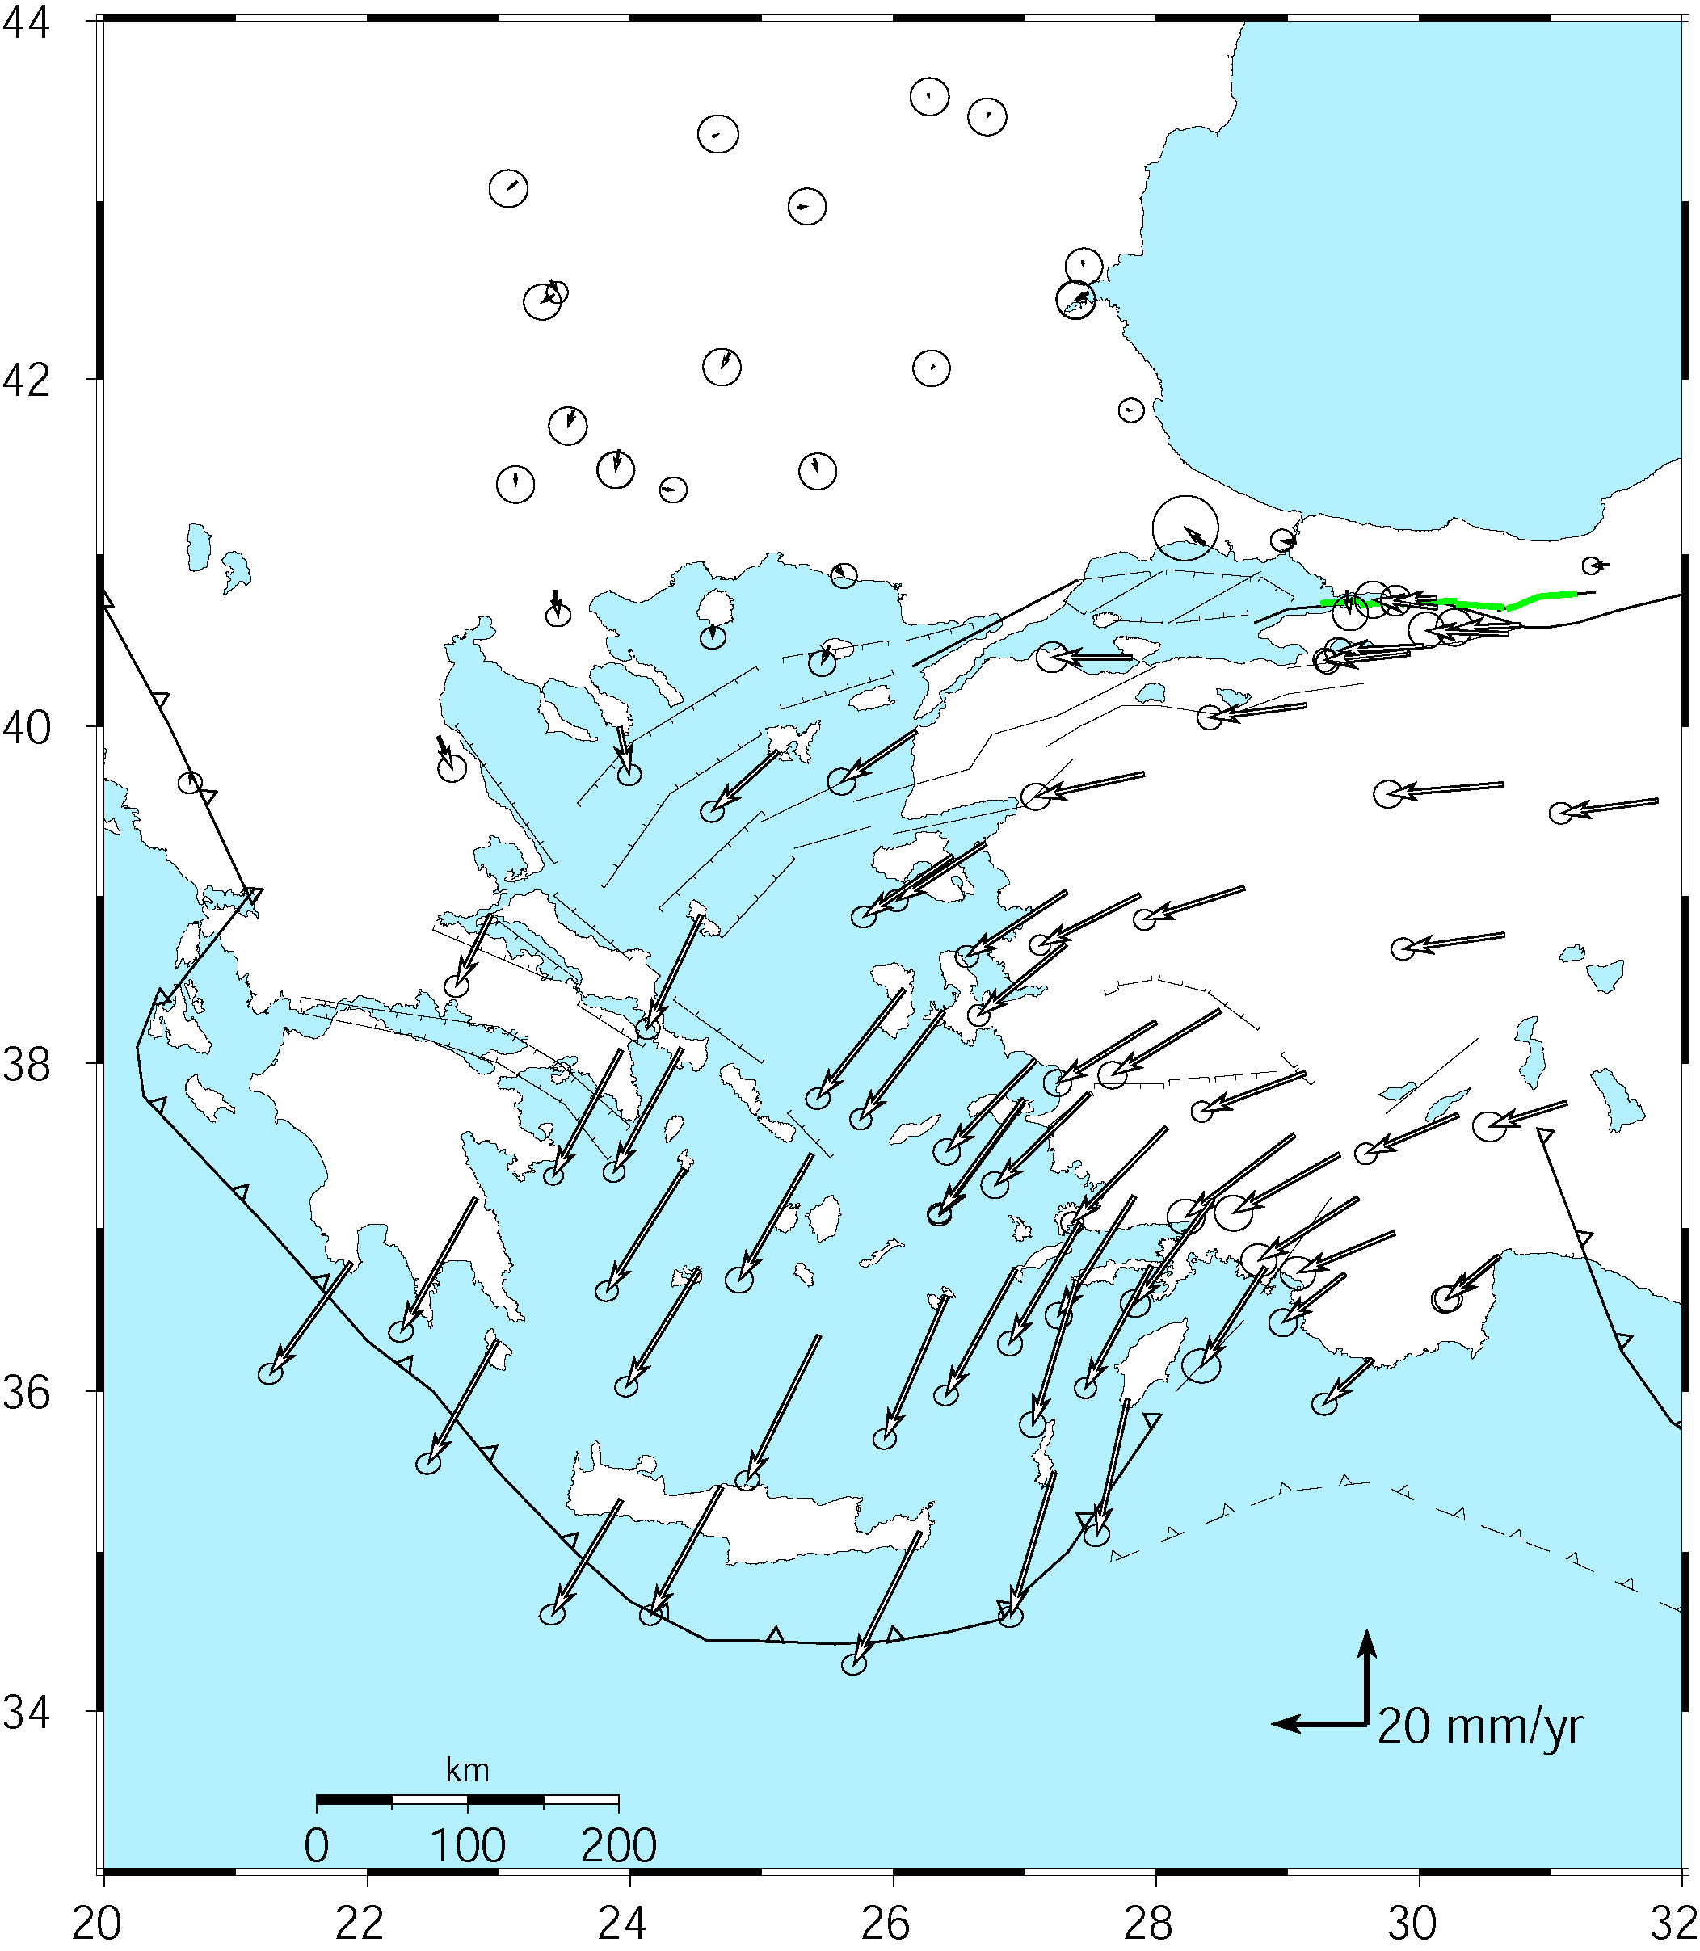
Velocities of Anatolia and the Aegean in a Eurasia reference frame
Realized by minimizing the velocities of 12 sites over the whole of Eurasia
McClusky et al. (2000)
Notes:
First let’s look at an example of representation of velocity-solution stabilization for visualization and interpretation.

Slide 35
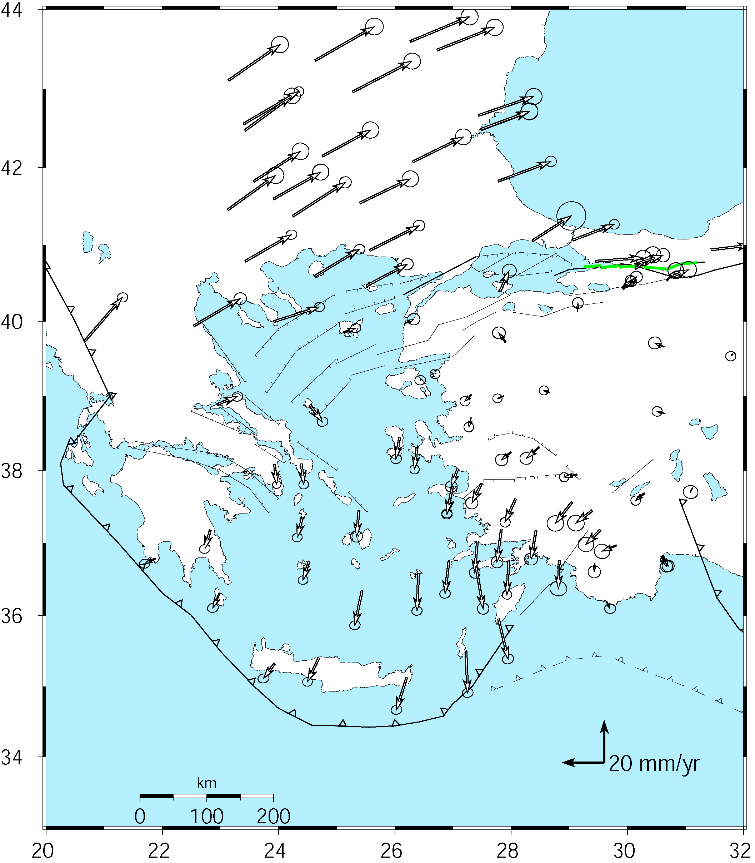
Velocities in an Anatolian reference frame
Better visualization of Anatolian and Aegean deformation
Here stations in Western/Central are used to align the reference frame (a priori velocity set to zero)
McClusky et al. (2000)
Notes:
Note that the major velocity gradients are still present: right-lateral shear across the North Anatolia fault and extension into the Aegean Sea, left-lateral shear and dilation around Rhodes.

Slide 36
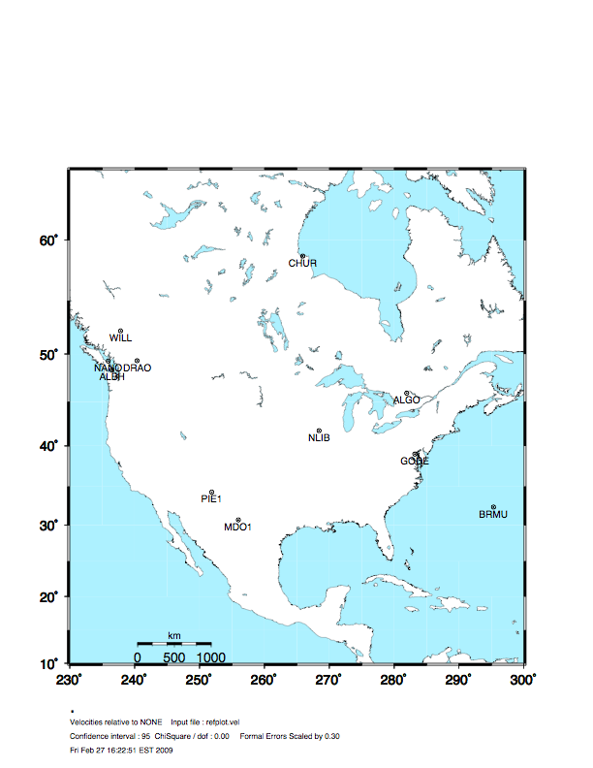
Stabilization Challenges for Time Series
Network too wide to estimate translation-only
(but reference sites too few or poorly distributed to estimate rotation robustly )
Notes:
Now an example of potential problems with time series stabilization. The picture shows the full network. We’ll look at what happens when you use various subsets of these stations for stabilization.

Slide 37
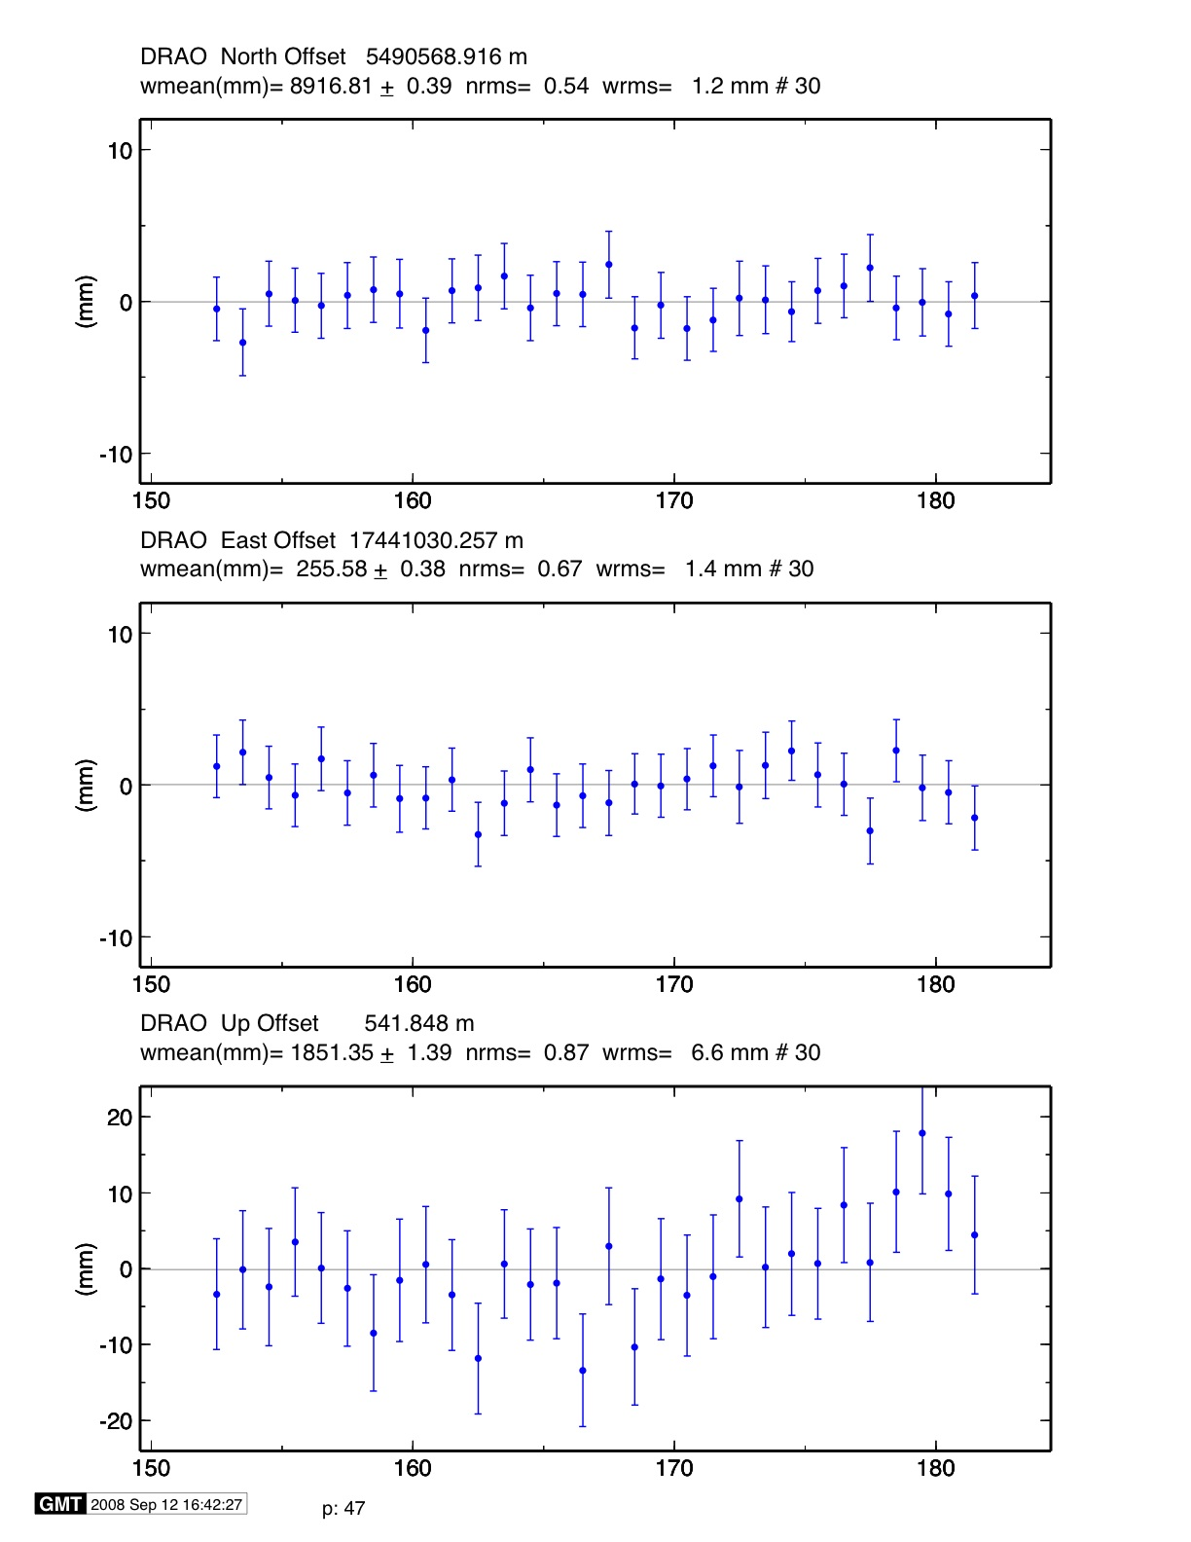
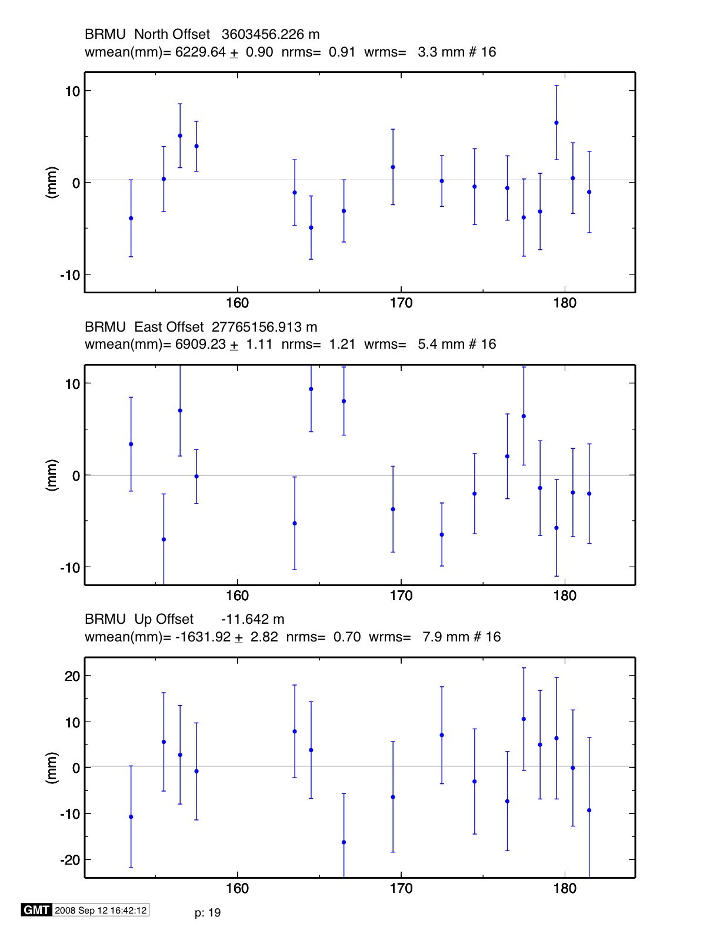
Stable reference frame
Stabilization Challenges for Time Series
*
Example of time series for which the available reference sites changes day-to-day but is robust (6 or more sites, well distributed, with translation and rotation estimated)
Day 176 ALGO PIE1 DRAO WILL ALBH NANO rms 1.5 mm
Day 177 ALGO NLIB CHUR PIE1 YELL DRAO WILL ALBH NANO
rms 2.3 mm
*
**
**
**
**
**
*
**
^ ^
^ ^
Notes:
The time series plots show the repeatability over 40 days for two sites, DRAO and BRMU., for the case where we have 9 stabilization sites on most days, but only 6 on day 176. In this case, even the 6 sites are well enough distributed and well enough behaved that day 176 is sill well stabilized.

Slide 38
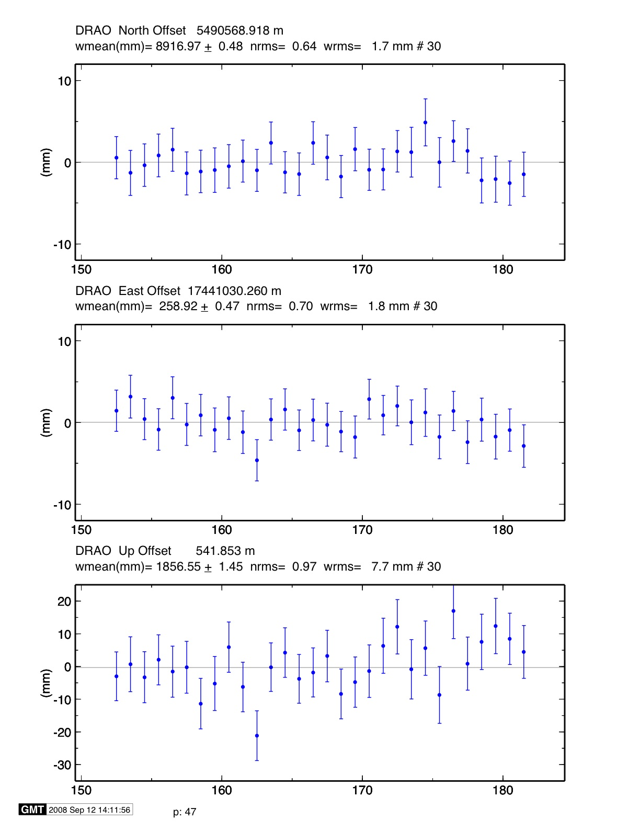
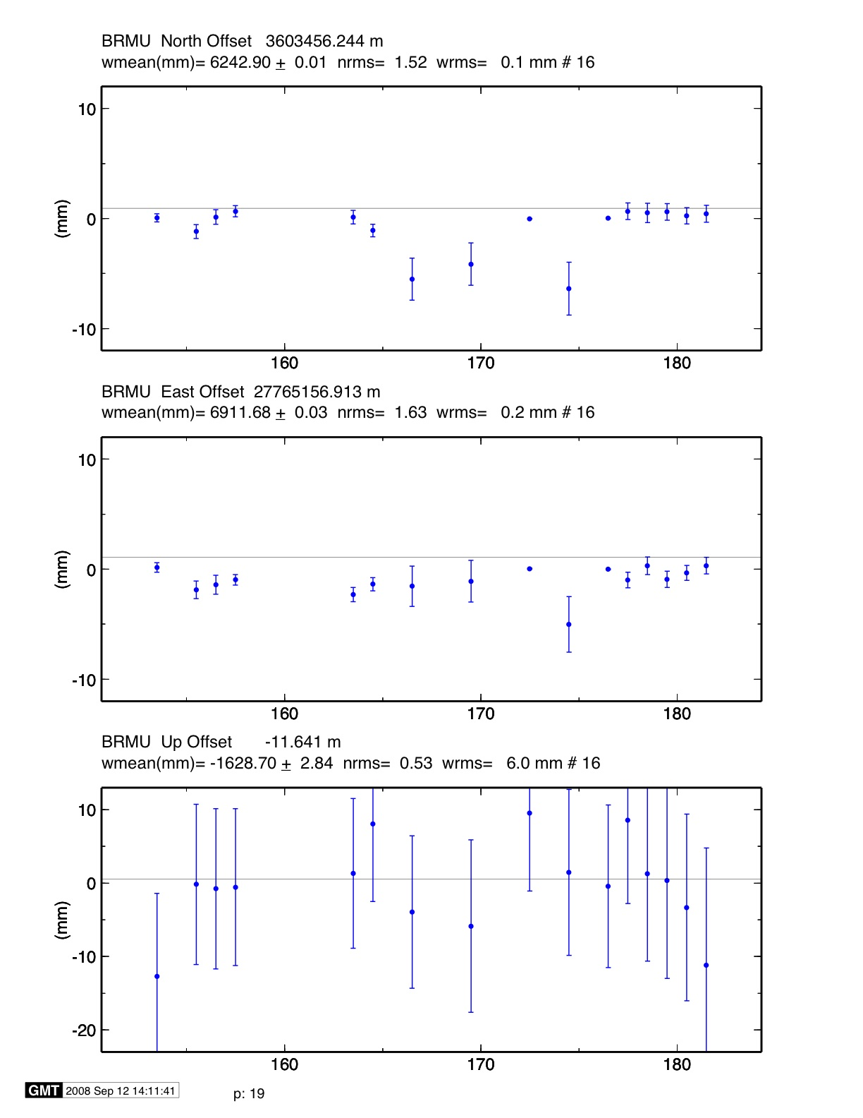
Unstable case
Stabilization Challenges for Time Series
*
Example of time series for which the available reference sites changes day-to-day and is not robust (only 3 sites on one day)
NOTE: Distant frame definition sites can have very small error bars when used and large error bars when not used.
Day 176 BRMU PIE1 WILL
rms 0.4 mm
Day 177 BRMU ALGO NLIB PIE1
YELL WILL
rms 2.0 mm
**
*
*
**
**
^ ^
^ ^
^ ^
^ ^
Notes:
In this case, however, the 6-site network is adequate for the core of the network (DRAO, but not for the edge (BRMU). On days when BRMU is in the stabilization, it aborbs all the rotatioin and have a tiny gimas, and on other days, it gets removed and has outliers with large sigmas.

